Slide 1
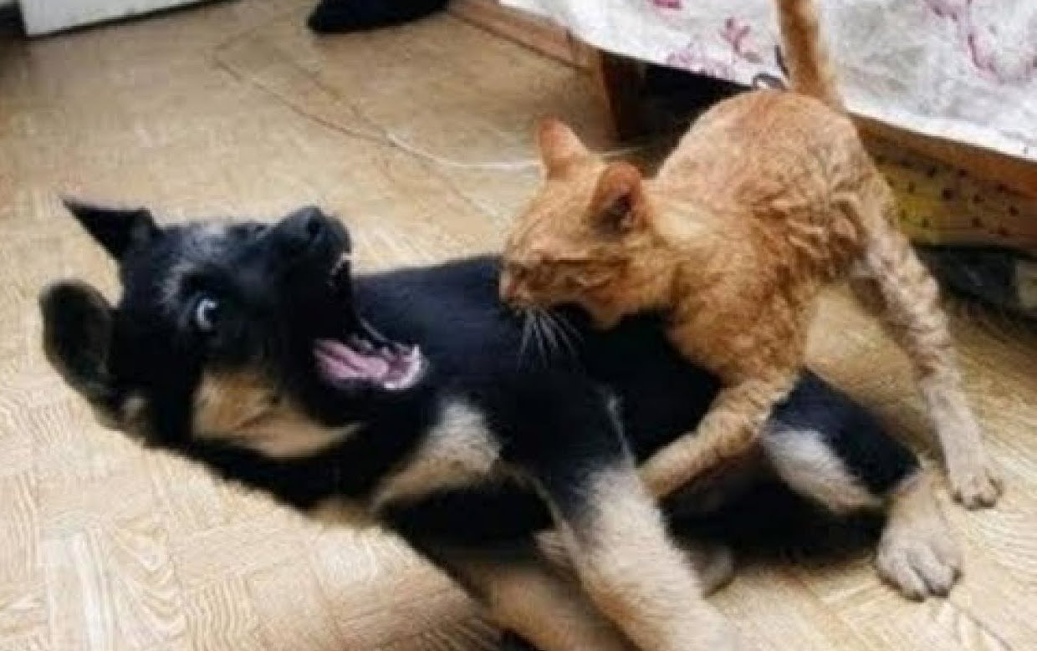
You need your Biome of the Day worksheet (We are doing 2 today)

Slide 2
BIOME
OF
THE DAY
sound 1
sound 2

Slide 3
Today’s biome is ……
the desert.

Slide 4
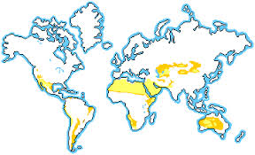
Abiotic factors
Hot days, cool nights
Very little precipitation (rainfall)

Slide 5
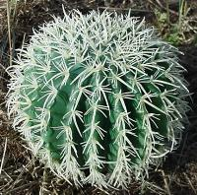
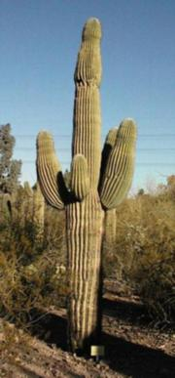
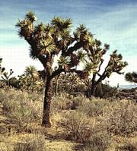
plants
Barrel Cactus
Joshua tree
Saguaro Cactus

Slide 6
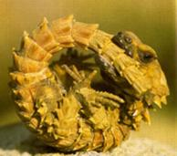
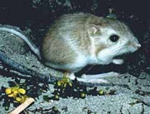
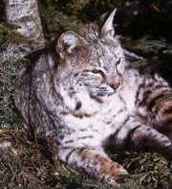
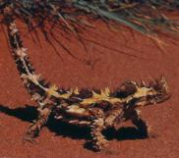
Animals
Armadillo Lizard
Bobcat
Kangaroo rat
Lots of lizards and snakes

Slide 7
Biome of the day
sound

Slide 8
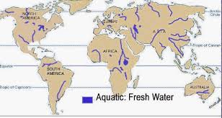
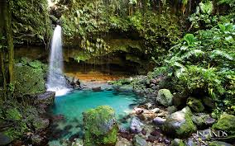
Today’s Biome is
Fresh water!

Slide 9
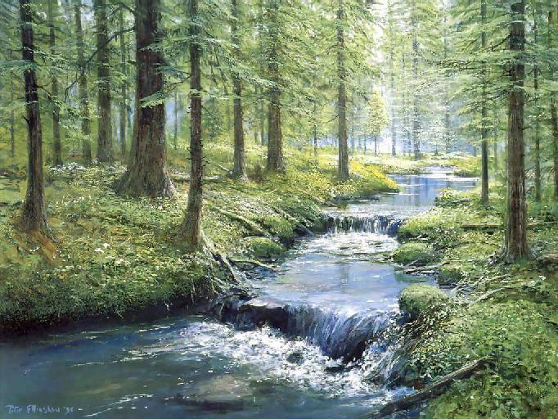
Abiotic
flowing or standing water
rocks & sediment
dissolved oxygen

Slide 10
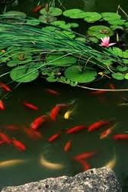
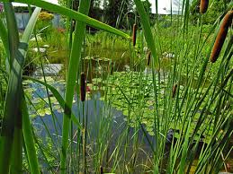
Plants
Cattails
Lily Pads
Muskgrass
Water Celery
Black Spruce Trees
Leaf Pond Weed
Duck Weed

Slide 11
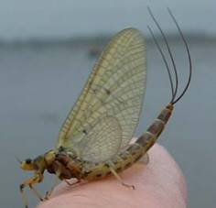
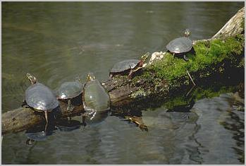
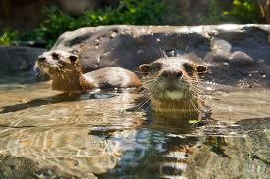
Animals
Fish
Amphibians (frogs, salamanders)
Otters
Beavers
Reptiles
Insects (such as ticks, dragonflies, etc.)

Slide 12
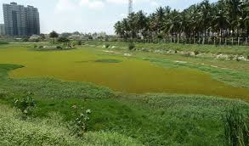
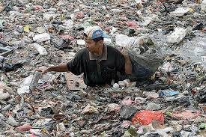
Human Impact
Eutrophication
Pollution

Slide 13
Cycling of Matter
What is the water cycle?
Why are plants and animals important for carbon and oxygen in an ecosystem?
Why must nitrogen cycle through an ecosystem?
Why must phosphorus cycle through an ecosystem?

Slide 14
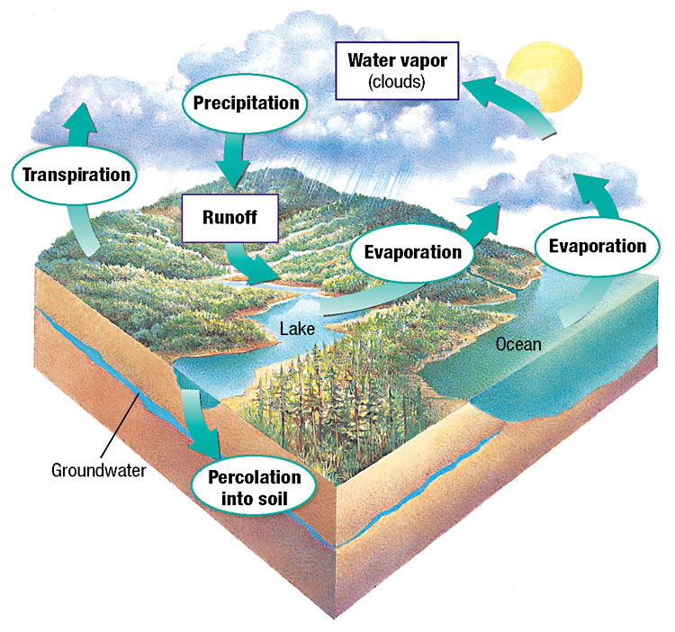
Water Cycle

Slide 15
Water cycle
Condensation: water condenses from gas into liquid in clouds.
Precipitation: Water falls from the atmosphere in the form of rain, snow, or sleet
Runoff: water runs into rivers ponds or oceans
Evaporation: water is heated by the sun into a gas state
Percolation: water moves through soil into ground water.
Transpiration: water evaporating off the leaves of plants.
Eutrophication: when a body of water becomes overly enriched with minerals and nutrients that induce excessive growth of plants and algae. This process may result in oxygen depletion of the water body. (We’ll do this later. ☺)

Slide 16
Water enters the atmosphere by evaporation. If water evaporates off of plants it is called transpiration. While in the atmosphere it condenses into precipitation. Some of the water percolates or soaks into the soil and becomes groundwater. Other water runs across the surface of the Earth into lakes, rivers, or the ocean. This is called runoff.

Slide 17
How do humans impact the water cycle?
Using/wasting too much water causing drought
Pollution enters the water through runoff
Too much water can cause erosion

Slide 18
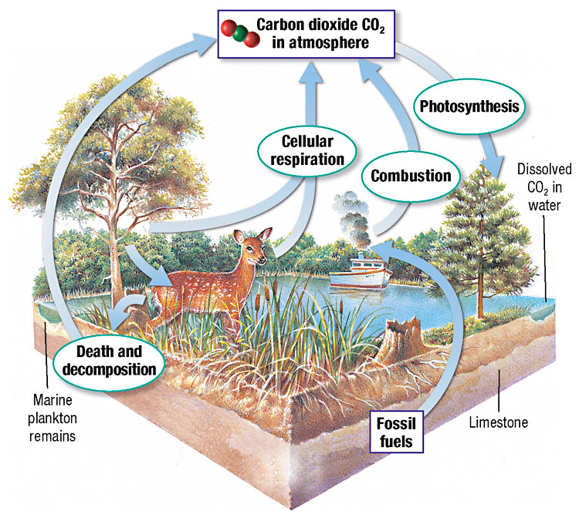
Carbon cycle

Slide 19
Carbon cycle
Decomposition: dead organisms breaking down and returning carbon to the soil.
Cellular respiration: animals breathe in oxygen and eat carbon. They breathe out CO2
Combustion: the burning of fossil fuels
Photosynthesis: plants absorb CO2 and create C6H12O6 for animals.
Fossil fuels: formed from the remains of dead plants and animals

Slide 20
Carbon is found mostly in the form of carbon dioxide (CO2) . Large amounts of carbon dioxide are found in the atmosphere and in soils. Plants use carbon dioxide in the air to make food in the process of photosynthesis. Animals take in oxygen and release carbon dioxide in the process of cellular respiration. Burning fossil fuels (combustion) also releases carbon dioxide into the atmosphere.
During decomposition dead matter is broken down and carbon is placed into the soil.

Slide 21
How do humans impact the carbon cycle?
Respiration & burning fossil fuels adds CO2 to the atmosphere. CO2 is a greenhouse gas which traps heat near the Earth’s surface.
Too much CO2 can cause an increase in global temperature and possibly lead to climate change.

Slide 22
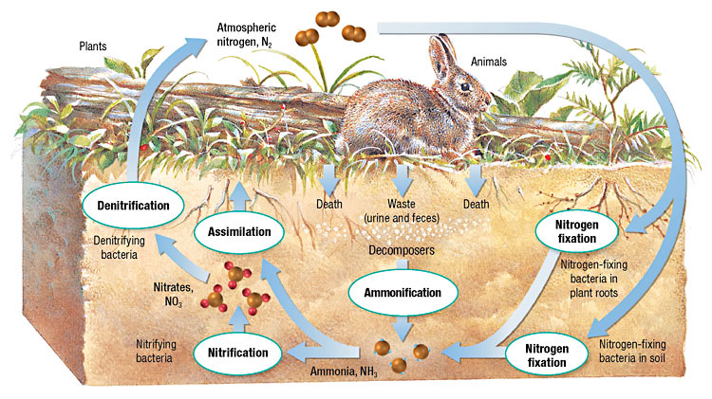
Nitrogen Cycle

Slide 23
Nitrogen cycle
Nitrogen fixation: combining nitrogen and hydrogen to form ammonia.
Denitrification: nitrate is changed to nitrogen gas and returned to atmosphere
Assimilation: plants absorb nitrogen.
Ammonification: animal waste becomes ammonia
Nitrogen fixing bacteria: live on the roots of some plants
Lightning: can change nitrogen to a usable form

Slide 24
Nitrogen cycle
All organisms need nitrogen to make amino acids which form proteins. The atmosphere is about 78% nitrogen. However, most organisms cannot use nitrogen gas. Some bacteria convert nitrogen to ammonia in the soil in a process called ammonification. Plants can then absorb the nitrogen in a process called assimilation. Decomposition is when nitrogen from animal waste or decaying bodies is returned to the soil by bacteria.
Finally, in denitrification, nitrogen is returned to the atmosphere.

Slide 25
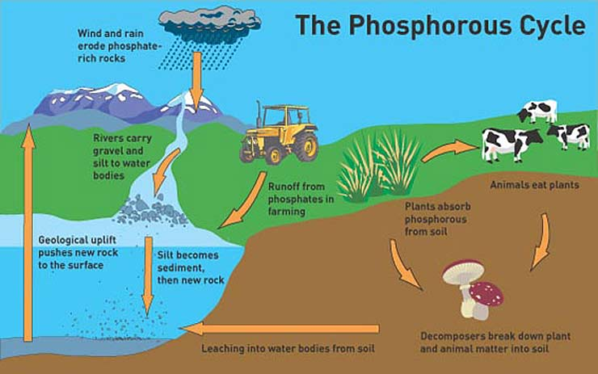
Phosphorus Cycle

Slide 26
Phosphorus Cycle
animal waste/fertilizer: contains high amounts of nitrogen and returns phosphorus to soil.
Consumption (eating) humans and animals
Limestone: phosphorus is found in the form of calcium phosphate.

Slide 27
Phosphorus is important for building ATP. Phosphorus never enters the atmosphere. It is mainly found in rocks, soil, and ocean water. Phosphorus can also be found in animal waste. Phosphorus gets into water by runoff. Plants absorb phosphorus through their roots and animals get phosphorus by eating plants. When plants and animals die the phosphorus is returned to the soil.

Slide 28
Nitrogen & phosphorus are found in fertilizer and animal waste. When humans use too much fertilizer it can run off into bodies of water. The nitrogen and phosphorus cause a lot of algae to grow. This is called an algae bloom. When the algae die bacteria decompose it. The bacteria use up most of the oxygen in the water causing fish and other aquatic animals to die. This whole process is called eutrophication.

Slide 29
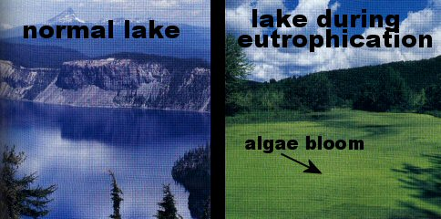

Slide 30
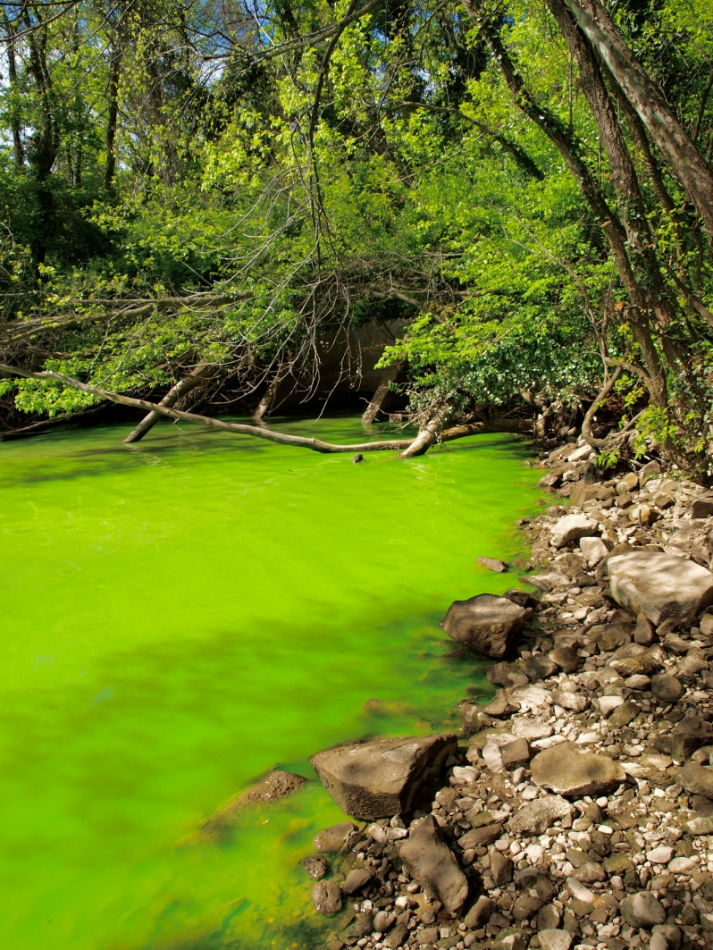
Totd
What is Eutrophication?

