Slide 1
Succession in Ecosystems
What is ecological succession?
What is a pioneer species?
What is the difference between primary and secondary succession?

Slide 2
Succession-
a series of changes in a community in which new populations of organisms gradually replace existing ones

Slide 3
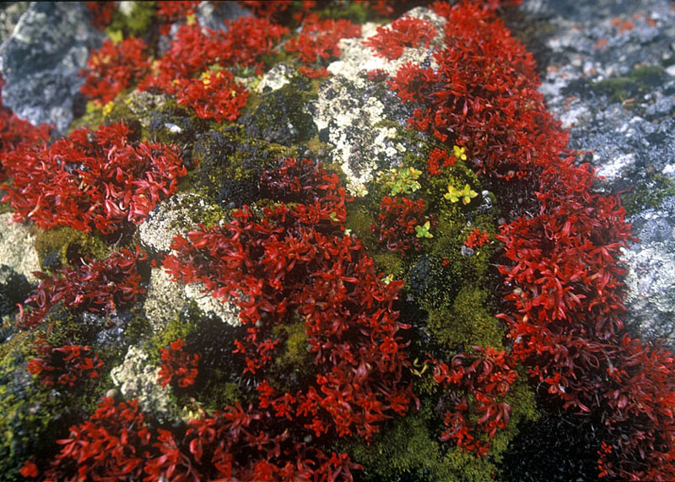
Primary succession-
colonization of new sites by communities of organisms – takes place on bare rock

Slide 4
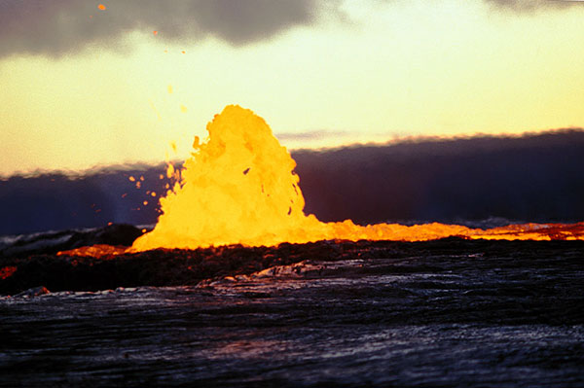
Primary succession-
New bare rock comes from 2 sources:
1. volcanic lava flow cools and forms rock

Slide 5
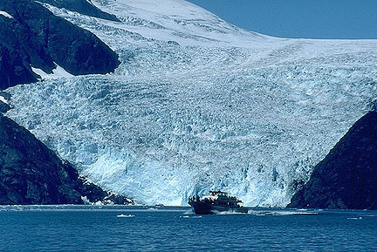
Primary succession-
New bare rock comes from 2 sources:
2. Glaciers retreat and expose rock

Slide 6
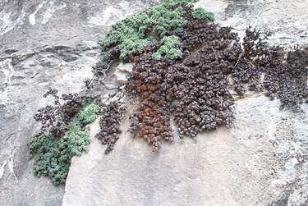
Pioneer organisms-
the first organisms to colonize a new site
Ex: lichens are the first to colonize lava rocks

Slide 7
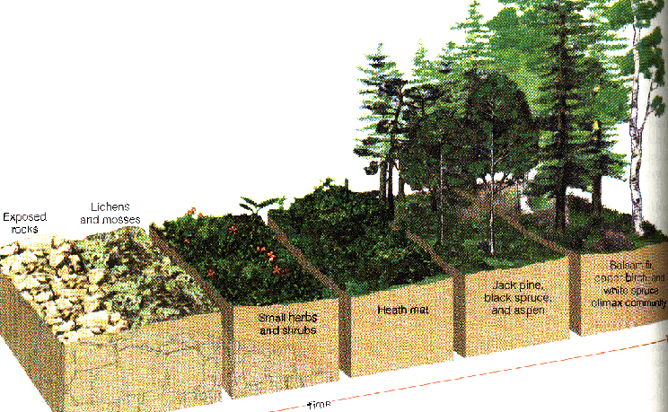
Primary Succession-
Rock

Slide 8
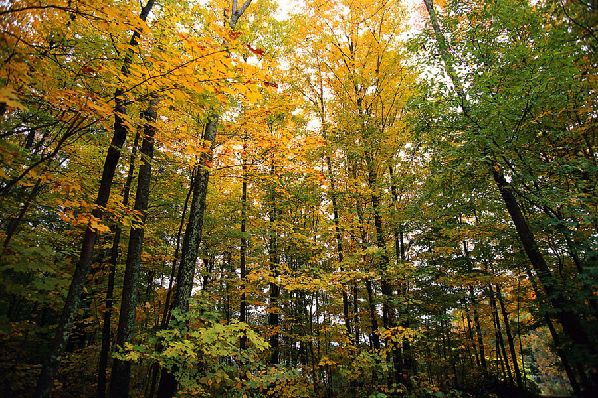
Climax community-
a stable, mature community that undergoes little or no succession

Slide 9
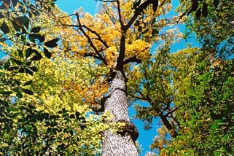
Climax community-
Ex: In most of georgia, the climax community would be a deciduous oak–hickory forest

Slide 10
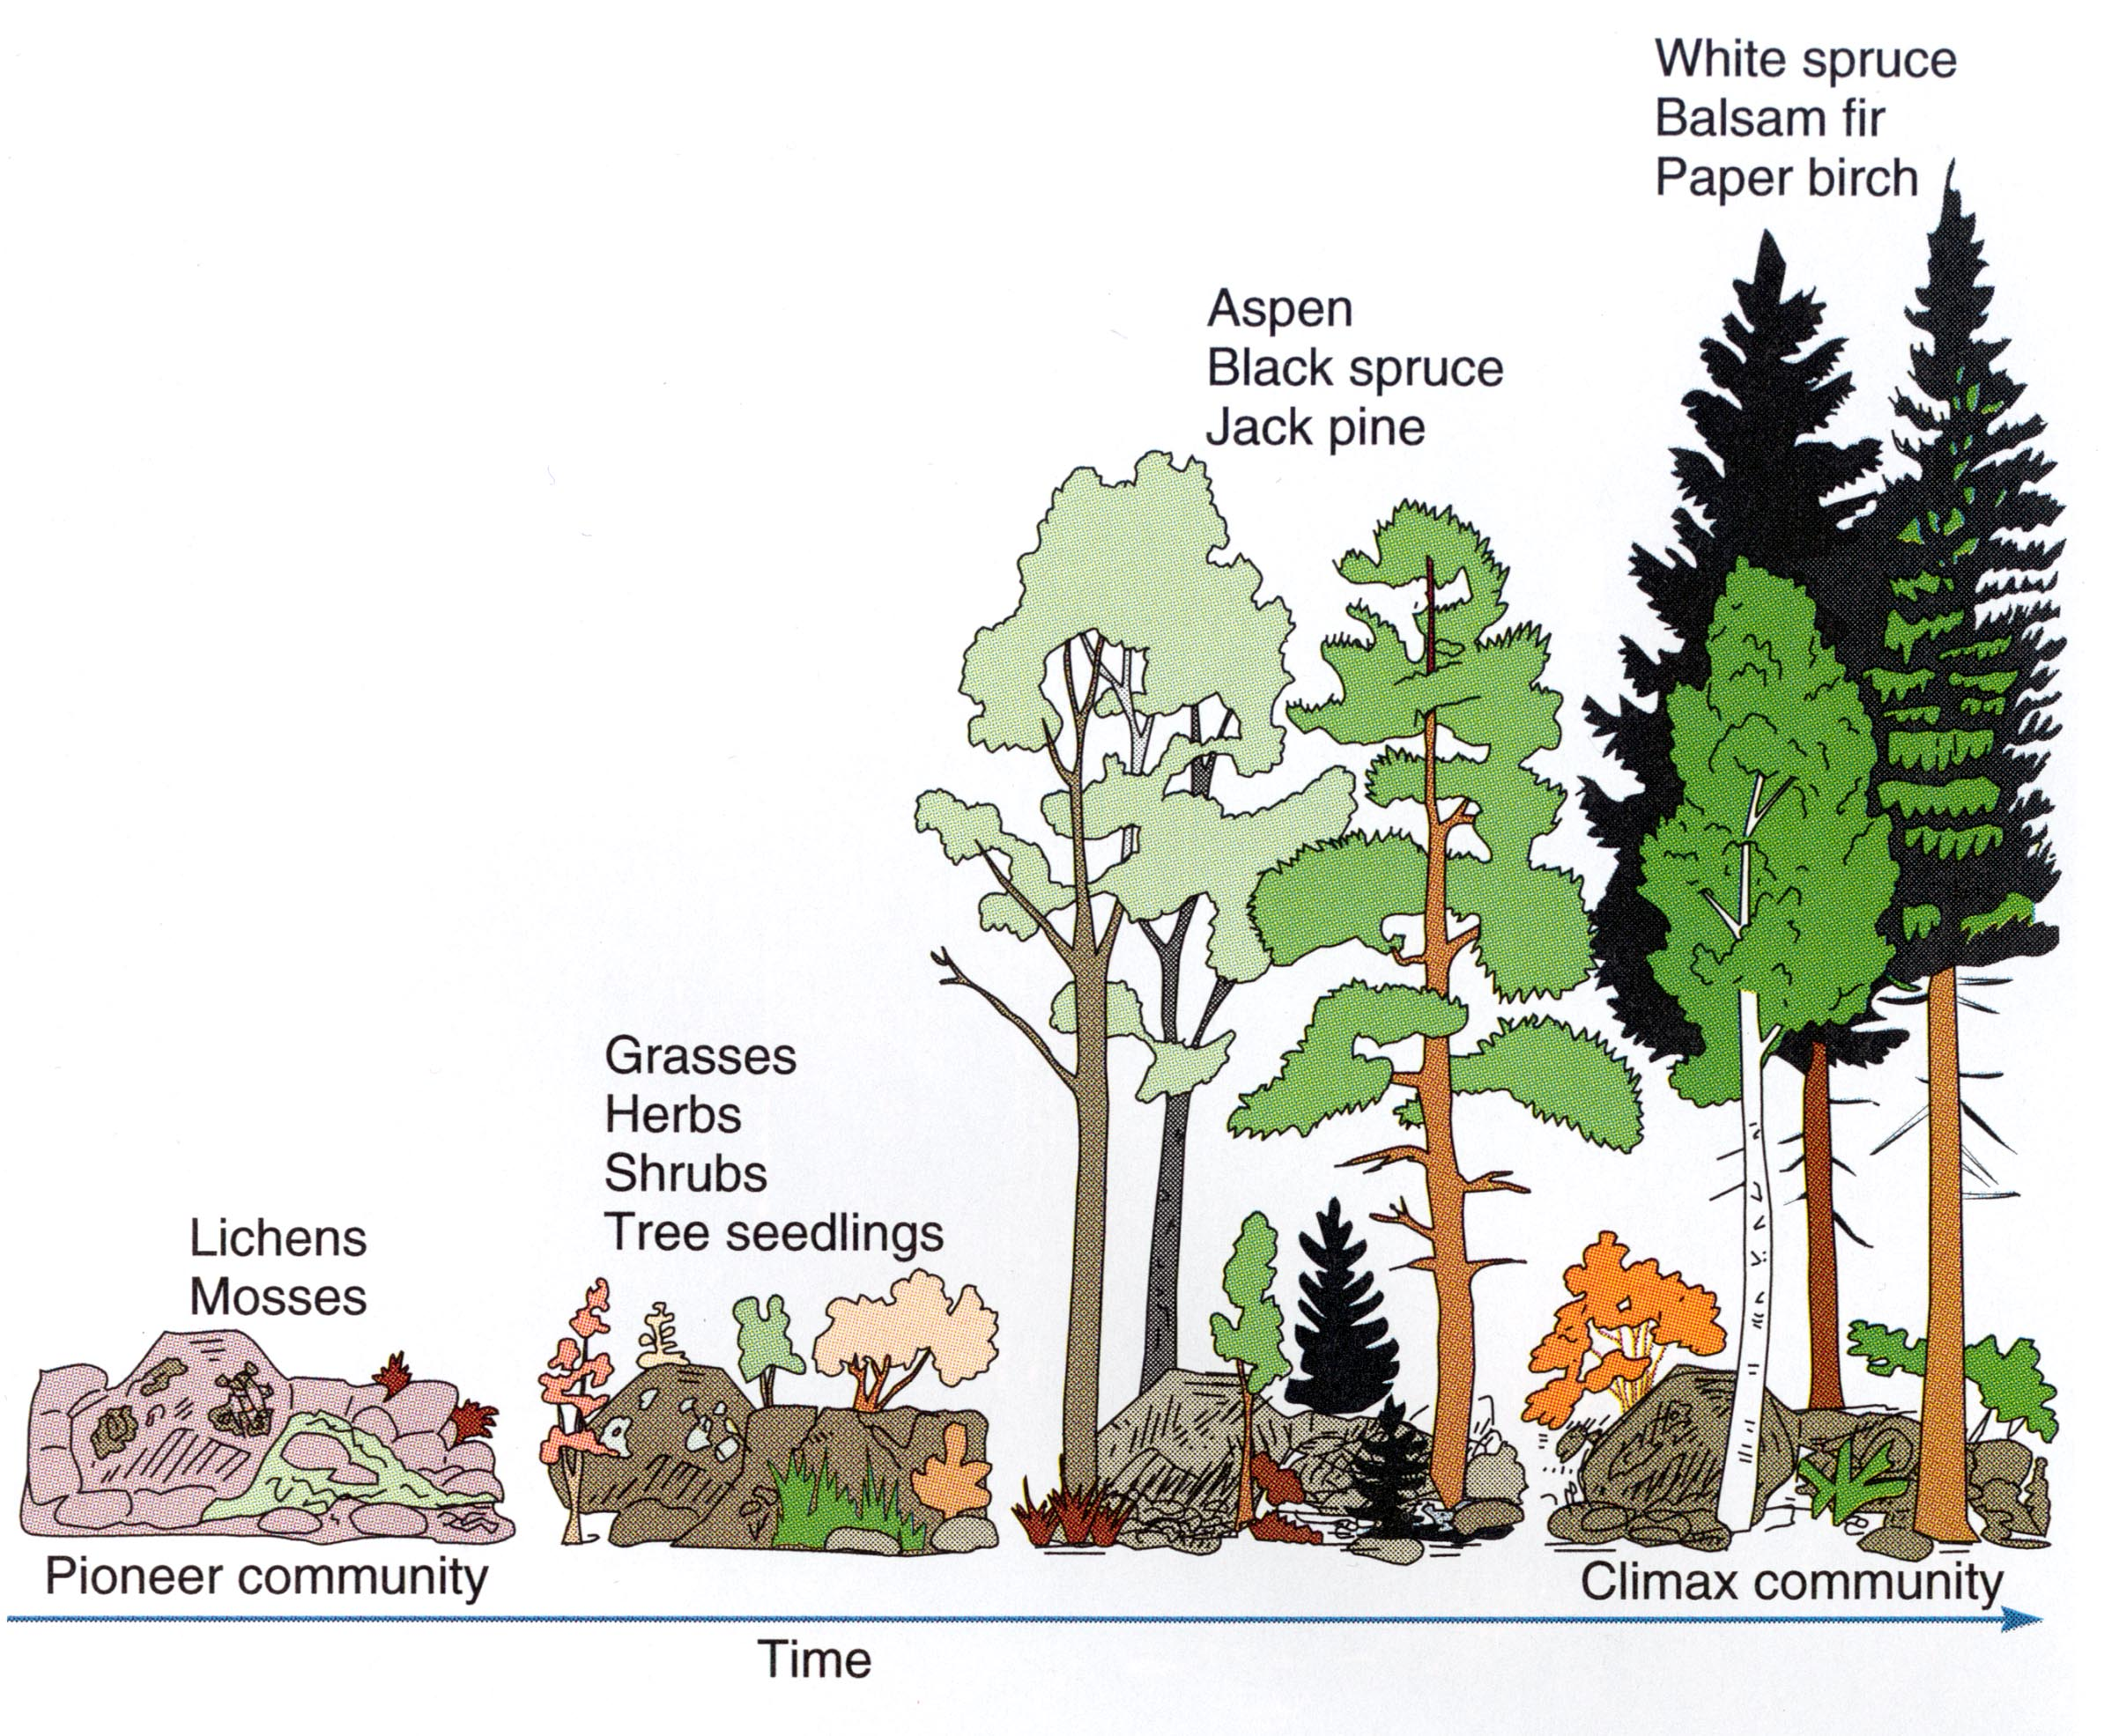
Primary succession-

Slide 11
Secondary succession-
sequence of community changes that takes place when a community is disrupted by natural disaster or human actions – takes place on existing soil

Slide 12
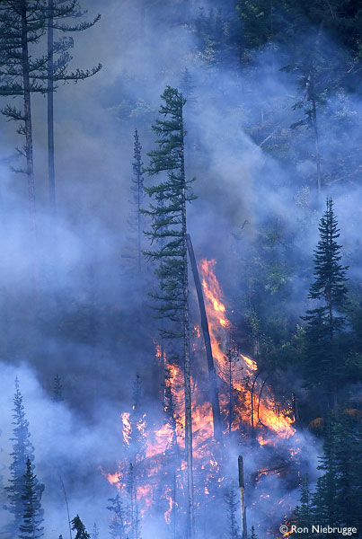
Secondary succession-
Ex:
A fire levels portions of a forest

Slide 13
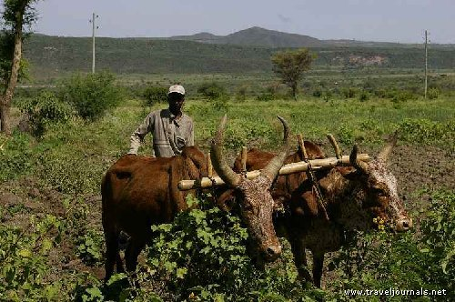
Secondary succession-
Ex:
A farmer plows his field

Slide 14
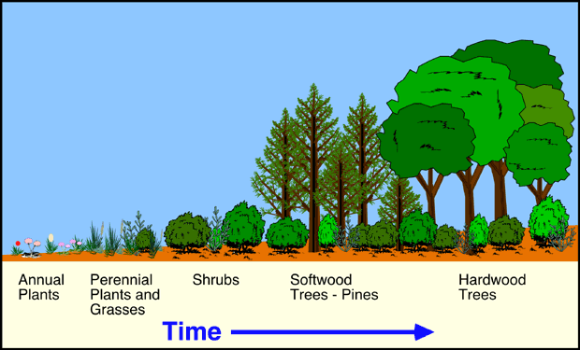
Secondary succession-

Slide 15
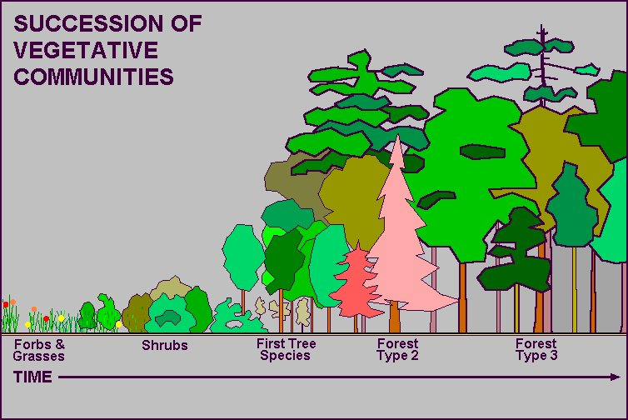
Secondary succession-

Slide 16
Create a Venn Diagram comparing & contrasting primary and secondary succession.
Both (3)
Secondary
(4)
Primary (4)

Slide 17
The following words or phrases MUST be included in your Venn Diagram
Abandoned farmland
Reaches a climax community
Cooled lava
Happens slower
Begins on existing soil
Forest fire
Has pioneer species
Shows changes in the ecosystem
Begins on bare rock
Abandoned parking lot
Happens faster

