Slide 1
Northernmost Biome
Biome of the Day

Slide 2
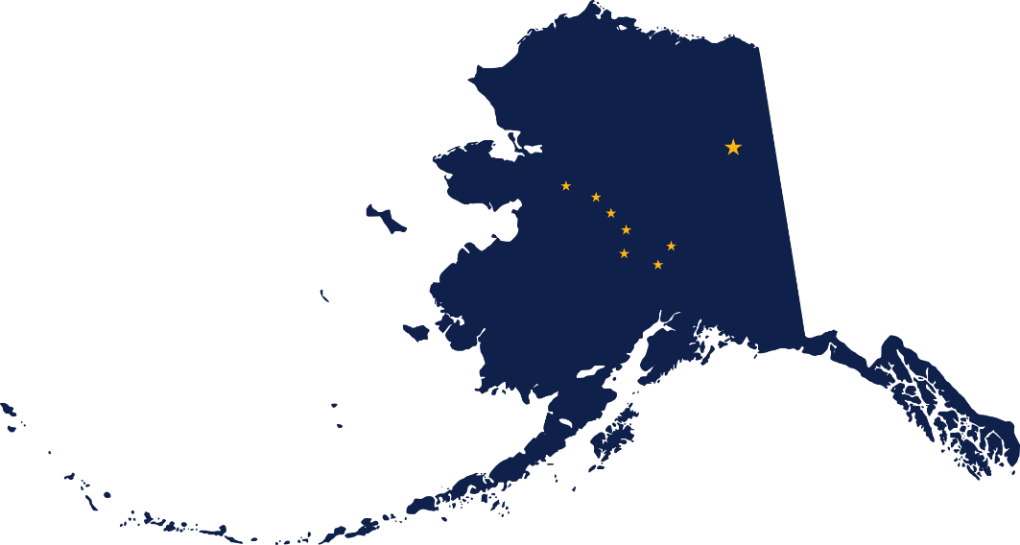
Location, Location, Location
Canada
Alaska
Siberia

Slide 3
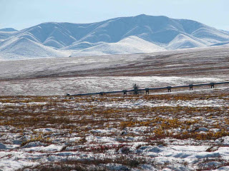
Climate
Less than 25 cm of precipitation/year
Very cold and dry

Slide 4
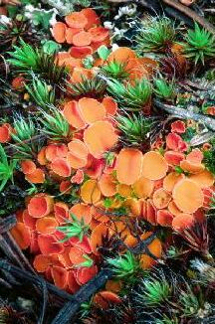
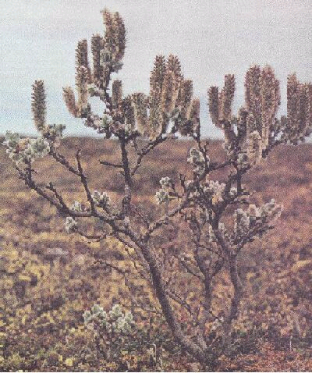
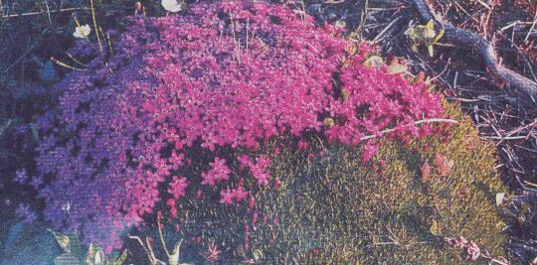
Plants
Reindeer moss
Lichen
True mosses
Grasses
Small shrubs

Slide 5
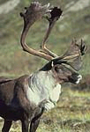
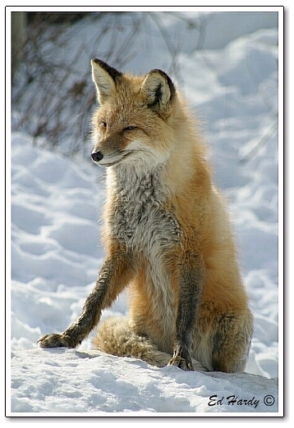
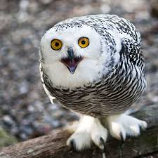
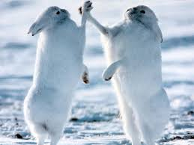
Animals
Insects
Snowy Owls
Caribou
Arctic Hares
Wolves
Foxes

Slide 6
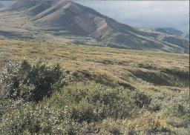
Abiotic Factors
Soil is poor
Permafrost

Slide 7
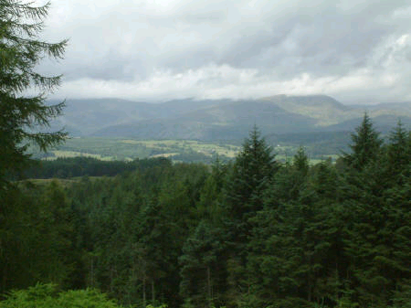
Biome of the Day
TAIGA
World’s Largest Biome

Slide 8
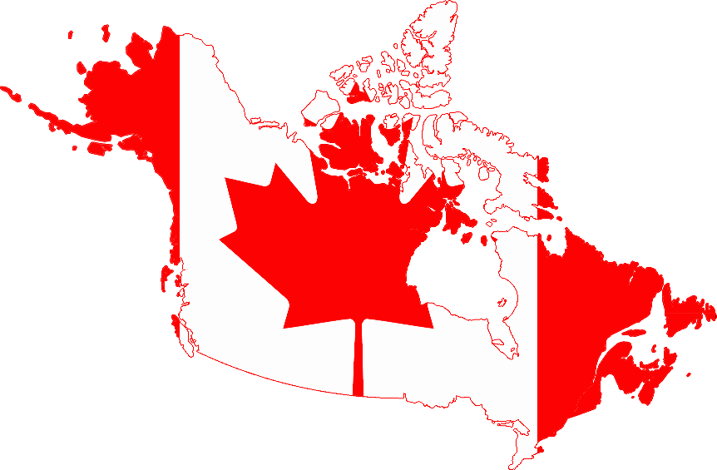
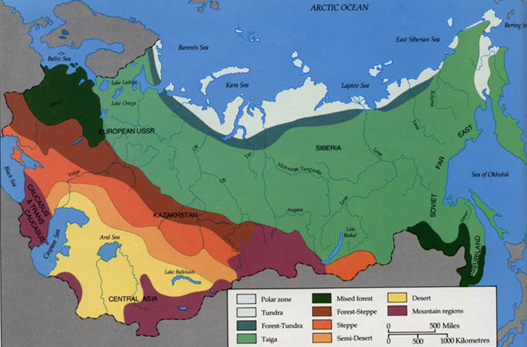
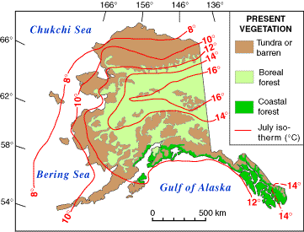
Location
Canada
Alaska
Russia

Slide 9
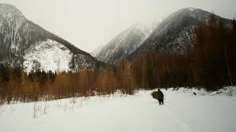
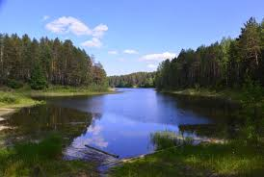
Climate
35-40 cm precipitation/year
Long, cold winters
Short, cool, rainy summers

Slide 10
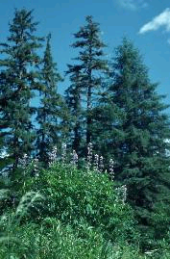
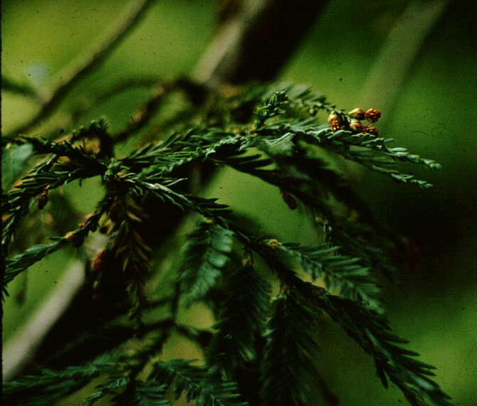
Plants
Coniferous trees
Firs
Spruce
Pine

Slide 11
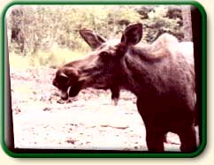
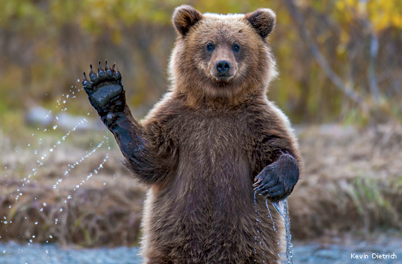
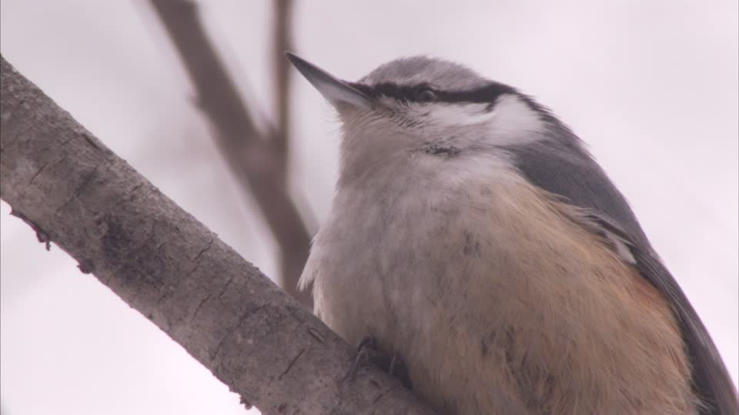
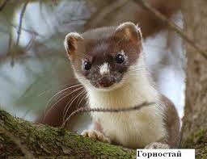
Animals
Moose
Bears
Birds
Small Mammals

Slide 12
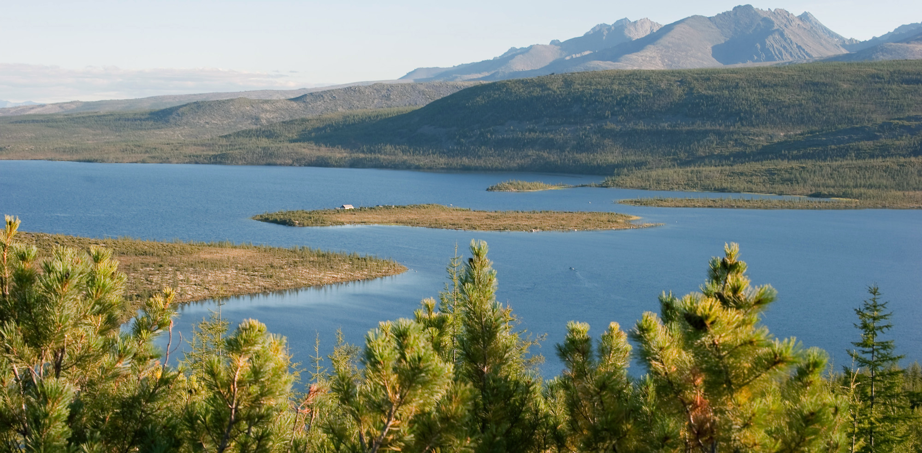
Abiotic Factors
Still poor soil
No permafrost

Slide 13
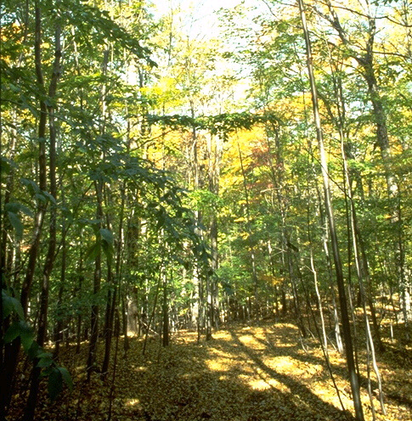
Biome of the Day
Temperate Deciduous Forest
We live here!

Slide 14
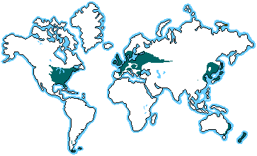
Where Are We?
Europe
Eastern U.S.A.
China

Slide 15
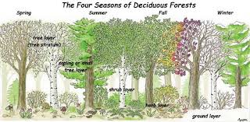
Climate
75-150 cm precipitation/year
Cold winters
Warm, wet summers

Slide 16
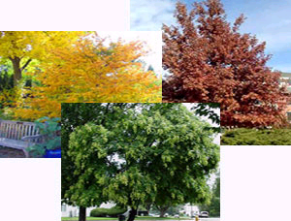
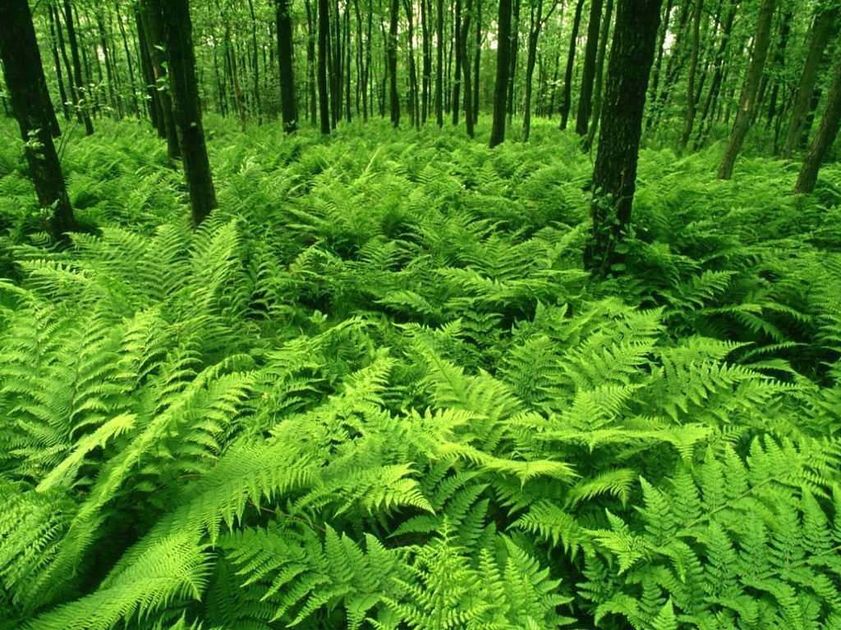
Plants
Oak trees
Shrubs
Flowers
Ferns

Slide 17
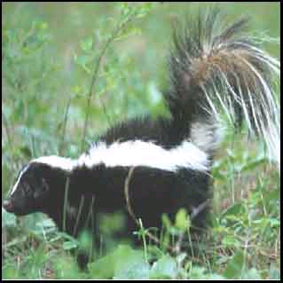
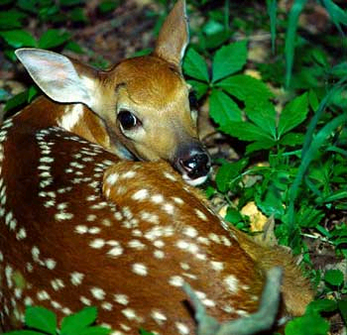
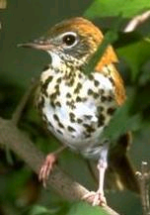
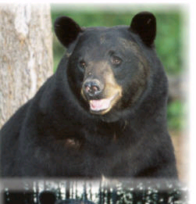
Animals
Deer
Skunks
Insects
Bears

Slide 18
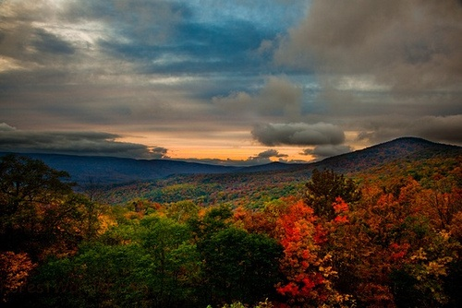
Abiotic Factors
Rich soil

