Slide 1
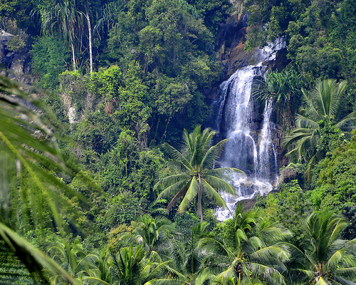
Biome of the Day
Tropical Rain Forest
Contains more than HALF of all species on Earth!

Slide 2
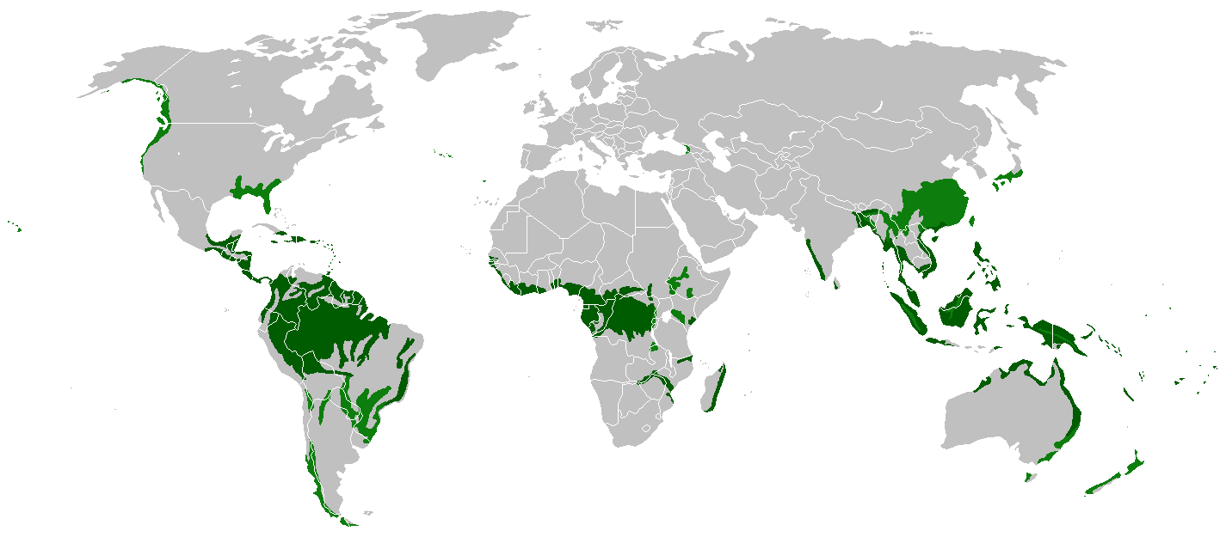
Whereabouts Do We Find It?
All along the equator

Slide 3
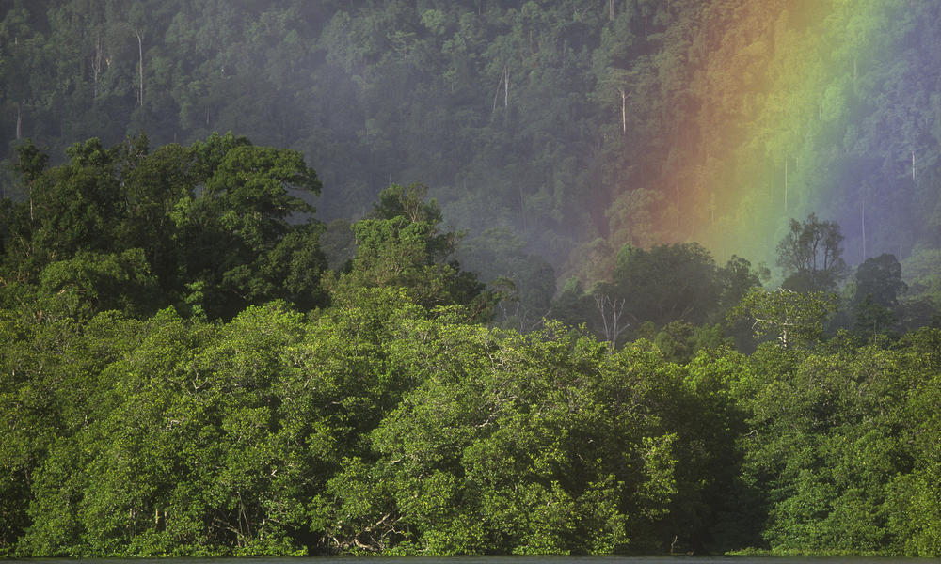
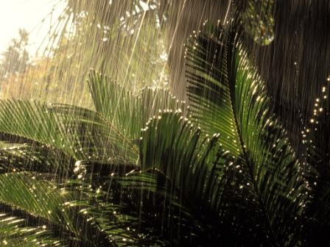
Climate
200-225 cm precipitation/year
Warm and wet year-round

Slide 4
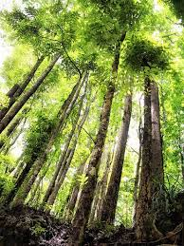
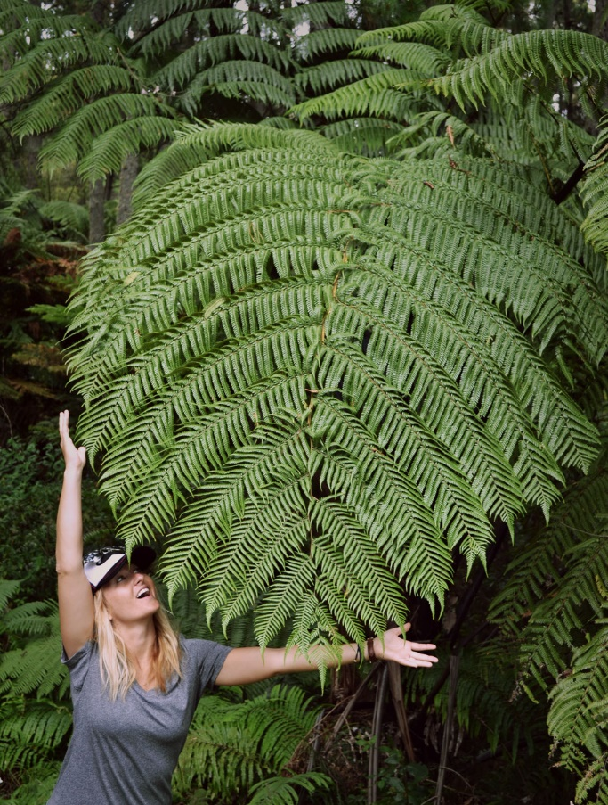
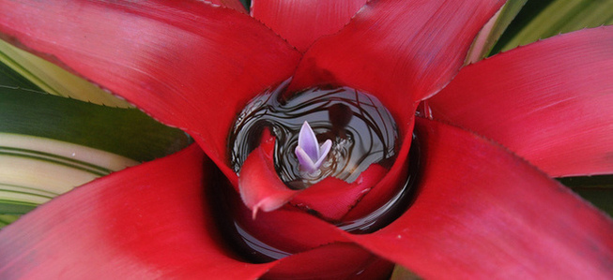
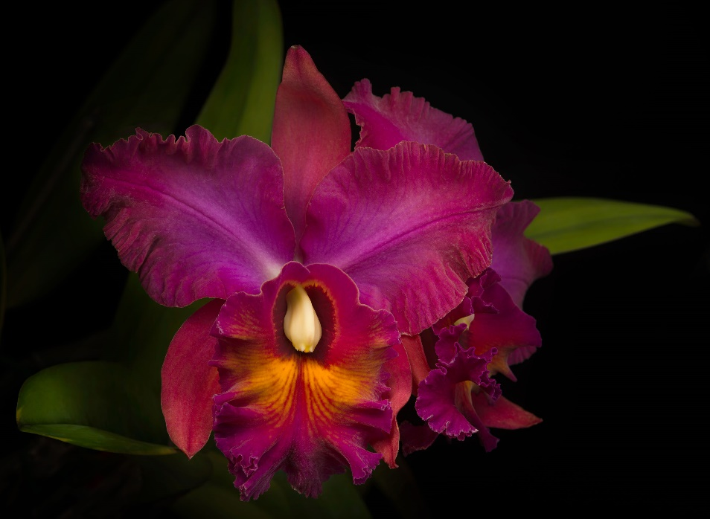
Plants
Mahogany trees
Bromeliads
Orchids
Giant ferns

Slide 5
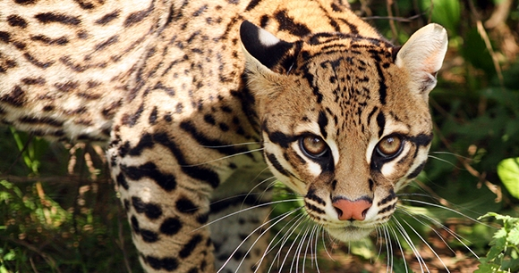
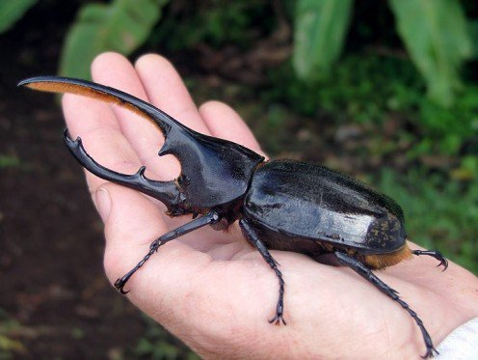
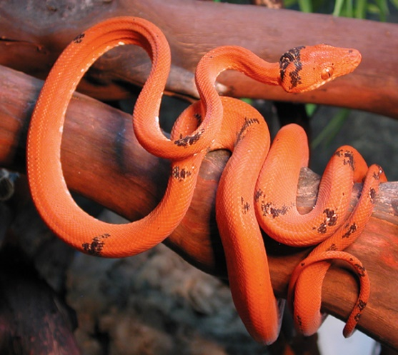
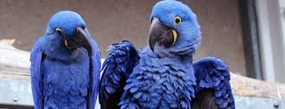
Animals
Monkeys
Snakes
Insects
Birds
Large cats

Slide 6
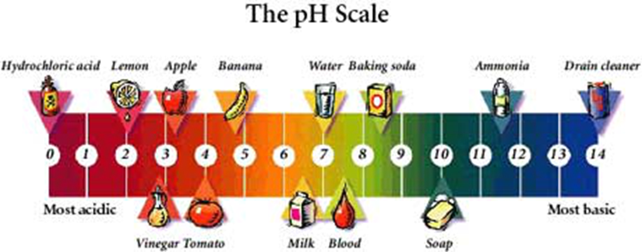
Abiotic Factors
Acidic soil

Slide 7
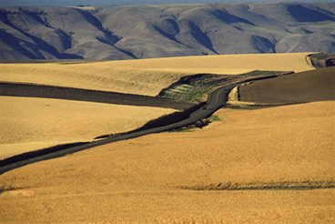
Grassland
Biome of the Day
Breadbasket of the World

Slide 8
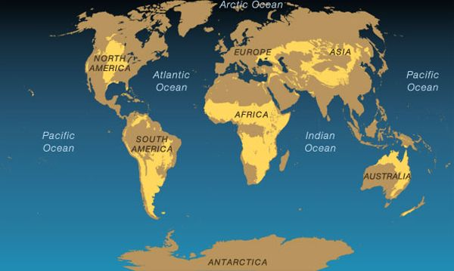
Where Art Thou?
USA
Asia
South America
Africa
Australia

Slide 9
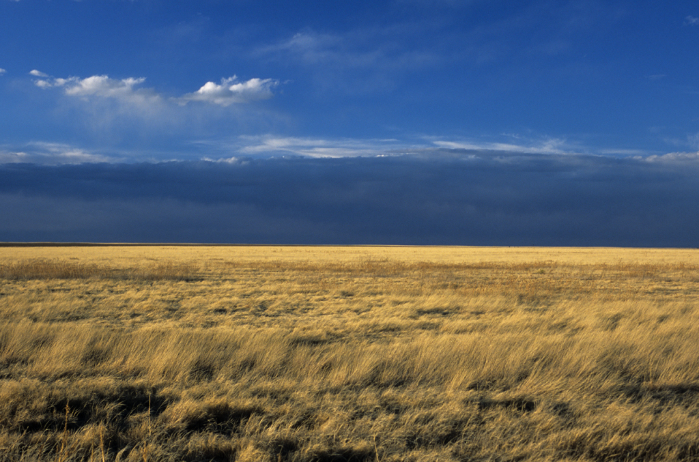
How’s the Weather (Climate) There?
25-75 cm precipitation/year
Wet areas and dry areas

Slide 10
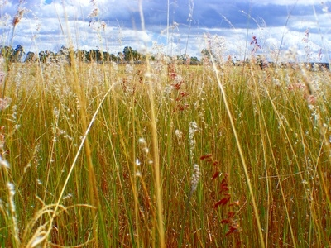
Plants
Wheat
Rye
Barley
Corn
Grass (duh.)

Slide 11
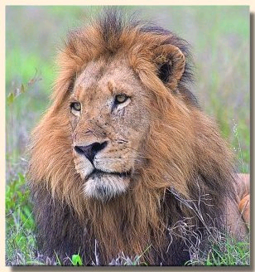
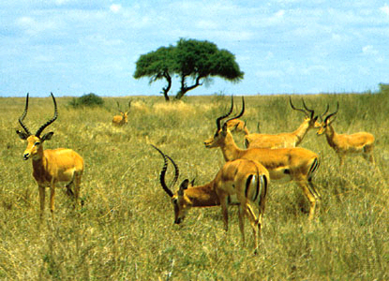
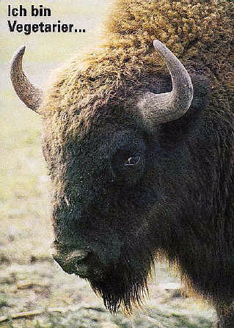
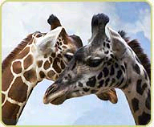
Animals
Bison
Lion
Gazelle
Prairie Dog
Giraffe
Kangaroo

Slide 12
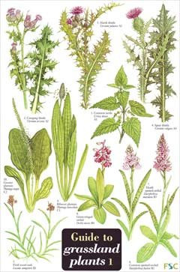
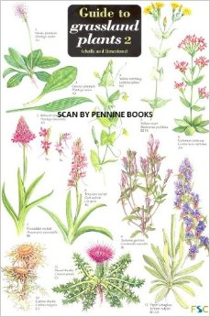
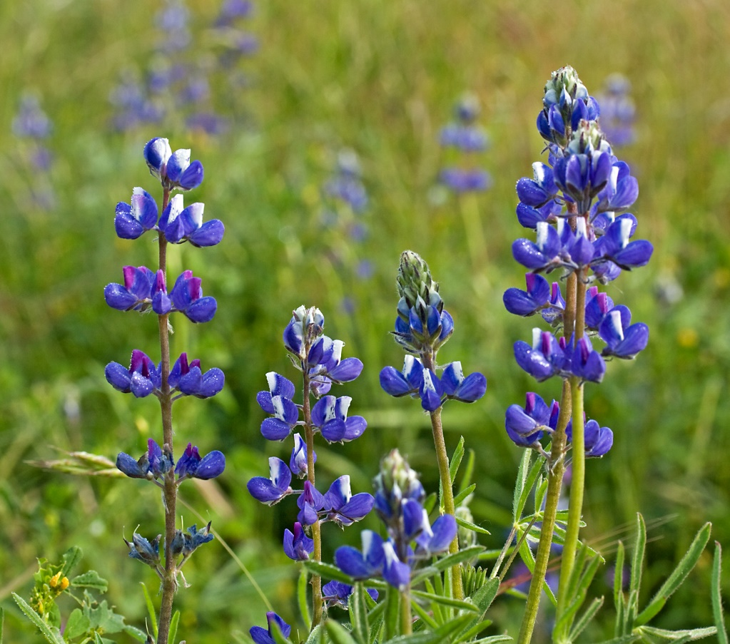
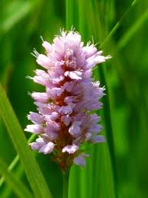
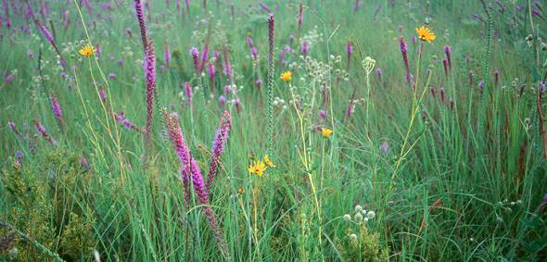
Abiotic Factors
Rich, fertile soil

Slide 13
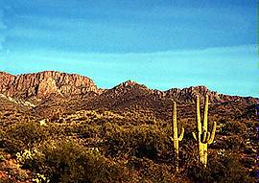
Biome of the Day
Desert
Driest Biome on Earth

Slide 14
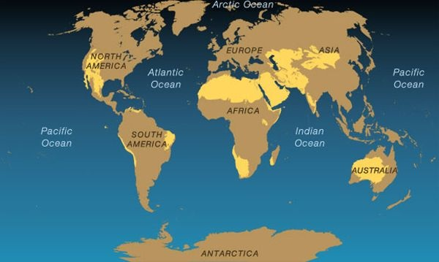
…And They’re Found Where?
Found on every continent (including Antarctica!)

Slide 15
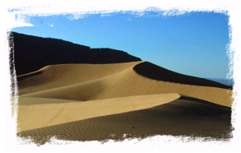
Climate
Less than 25 cm precipitation/year
Hot days
Cold nights
Very dry

Slide 16
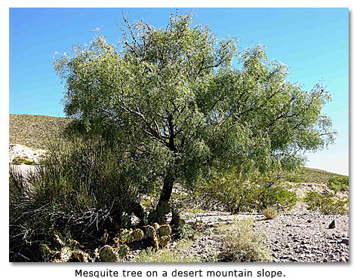
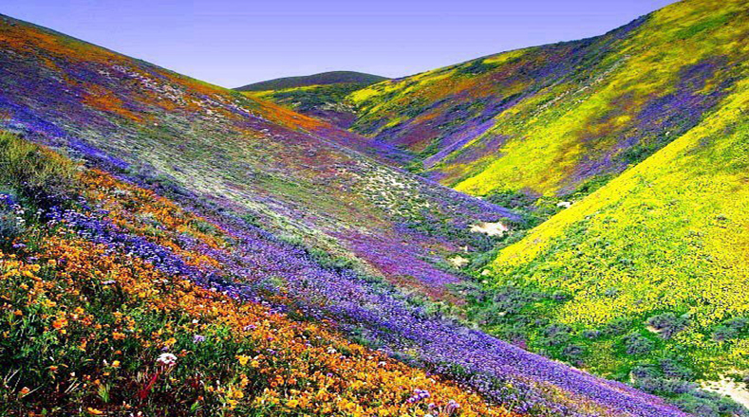
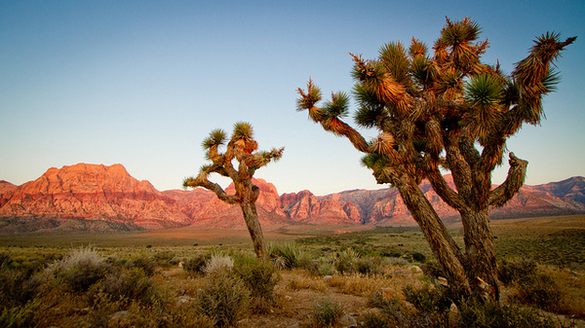
Plants
Cactus
Mesquite
Joshua tree
Wild flowers

Slide 17
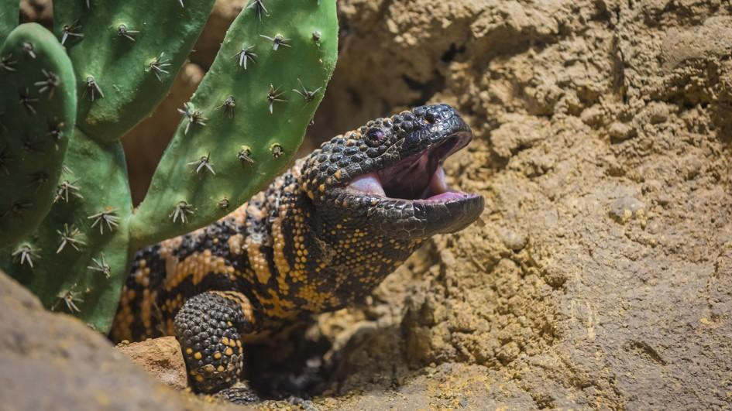
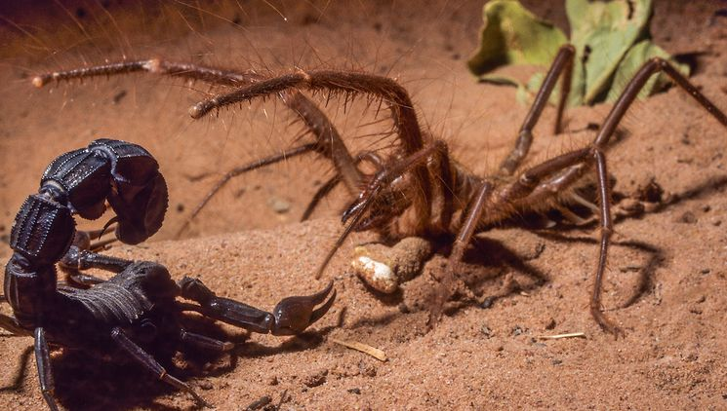
Animals
Lizards
Camels
Snakes
Scorpions
Spiders

Slide 18
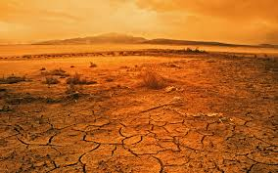
Abiotic Factors
Soil is nutrient poor

Slide 19
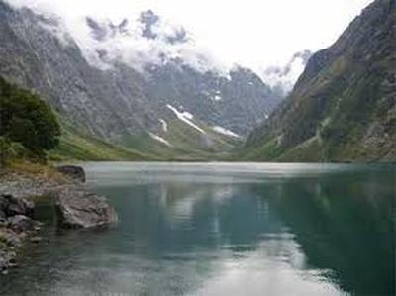
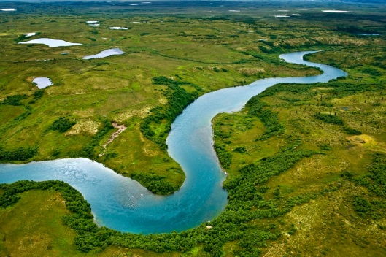
Freshwater Ecosystems
Biome of the Day
Streams
Rivers
Ponds
Lakes

Slide 20
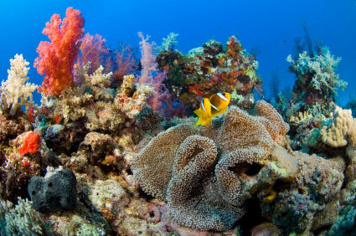
Marine Ecosystems
Biome of the Day
Estuaries
Intertidal Zones
Neritic Zones
Open Ocean

Slide 21
Estuaries
Coastal areas
Freshwater meets salt water

Slide 22
Intertidal Zone
Rocky
Where ocean meets the coast
Think “beach”
Animals adapt for protection

Slide 23
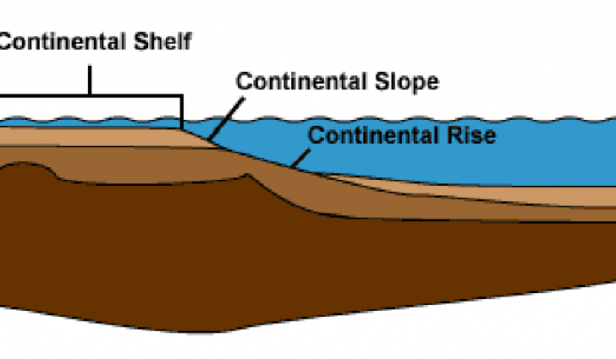
Neritic Zone
Farther out than intertidal
Area over continental shelf

Slide 24
Open Ocean
Deep part of the ocean
No light in depths, so animals have adaptations such as bioluminescence

