Slide 1
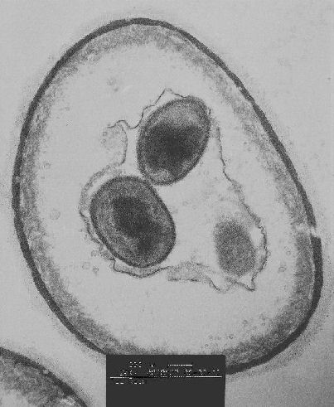
Cellular Transport Notes

Slide 2
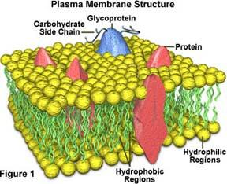
All cells have a cell membrane
Function: controls what enters and exits the cell to maintain homeostasis (internal balance)
Provides protection and support for the cell

Slide 3
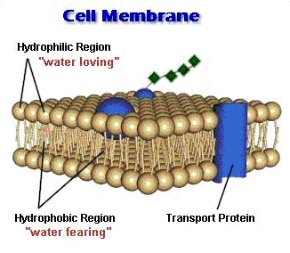
A cell membrane is semipermeable
Some substances can pass directly through the cell membrane while other substances can not.
Materials can enter or exit through the cell membrane by passive transport or active transport.

Slide 4
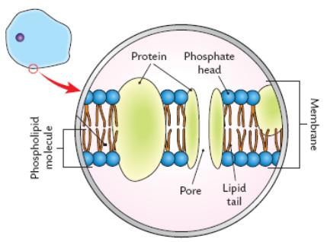
Draw this:

Slide 5
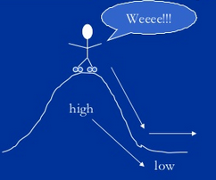
Passive Transport: Cell doesn’t use energy

Slide 6
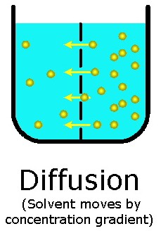
Diffusion: Molecules spread across membrane until they are equally concentrated

Slide 7
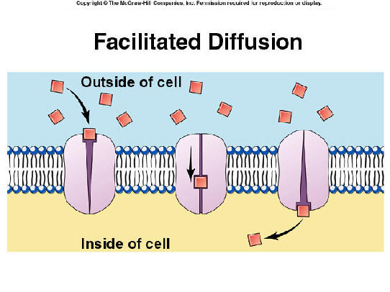
Facilitated diffusion: Diffusion with the help of transport proteins.

Slide 8
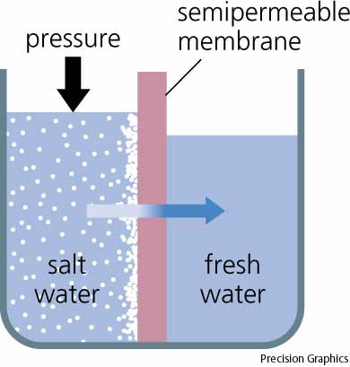
Osmosis: Diffusion of water

Slide 9
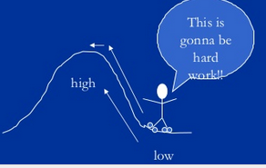
Active Transport
Cell does use energy

Slide 10
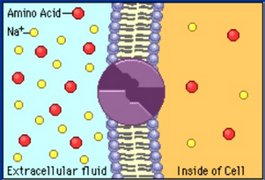
Protein pumps: Protein changes shape to move molecules.
Transport proteins that require energy to do work (example: sodium/potassium pumps for nerves)

Slide 11
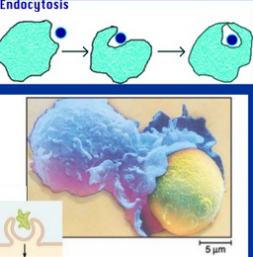
Endocytosis
Brings food in
Cell membrane folds around food particle
White blood cells “eat” bacteria

Slide 12
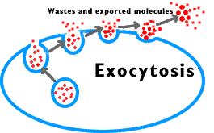
Exocytosis
Forces material out of cell
Cell changes shape and requires energy
Ex Hormones or wastes released from cell
demo

Slide 13
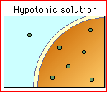
Hypotonic Solution
The solution has a lower concentration of solute and higher concentration of water.
Water will move into the cell
Cell will swell and burst
(lyse)

Slide 14
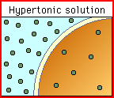
Hypertonic
The solution has a higher concentration of solutes and less water than inside the cell
Water moves out of cell an cell shrinks

Slide 15
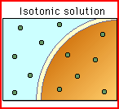
Isotonic
The concentration of solutes and water is the same inside and outside the cell
Water moves equally across the membrane

Slide 16
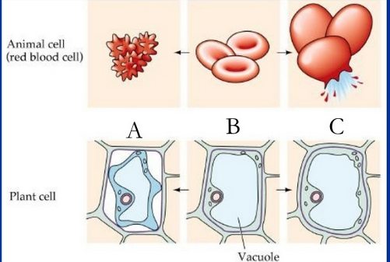
Try it: what type of solution?

