Slide 2
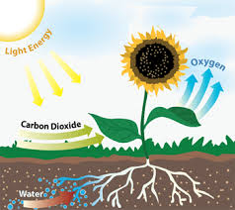
Photosynthesis

Slide 3
Equation

Slide 4
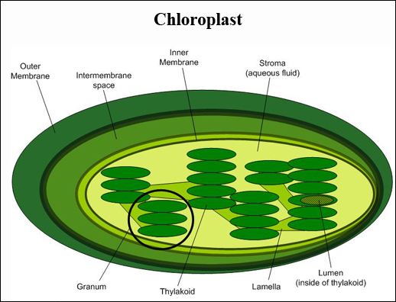
2 Stages of Photosynthesis
Light dependent reactions
Calvin Cycle (light independent reaction

Slide 5
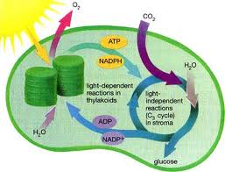
Light Dependent Reaction
requires light
produces energy (ATP)

Slide 6
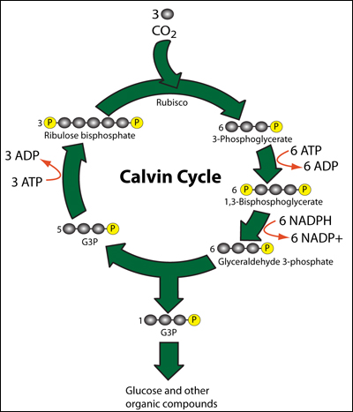
Calvin Cycle
does not require light
uses ATP from light dependent reaction to make glucose

Slide 7
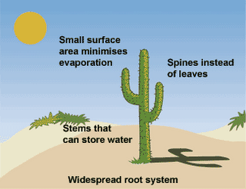
Factors Affecting Photosynthesis
amount of water
amount of light
temperature

Slide 8
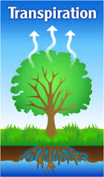
Transpiration
Water evaporates from leaves
As water evaporates off leaf it pulls more water up from roots

Slide 10
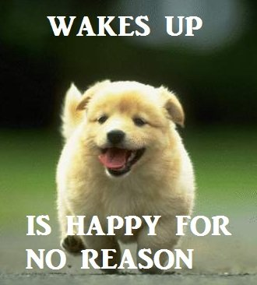

Slide 11
Key questions
What is energy?
What is ATP
What is the formula for cellular respiration?
What are the parts of cellular respiration?
What are the two types of anaerobic respiration?

Slide 12
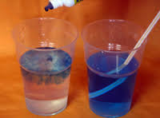
BTB Demo

Slide 13
Energy
Capacity to move or change matter
Chemical energy is the energy contained in the chemical bonds of molecules
^{1st} law- Energy cannot be created or destroyed.

Slide 14
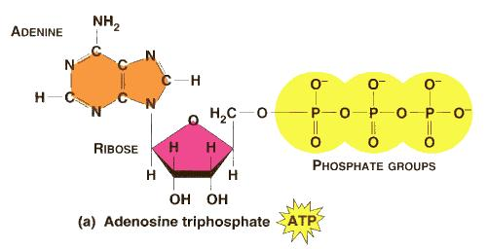
Adenosine triphosphate (ATP)
Energy carrying molecule used by cells to fuel their cellular processes
ATP is composed of an adenine base, ribose sugar, & 3 phosphate (PO₄) groups

Slide 15
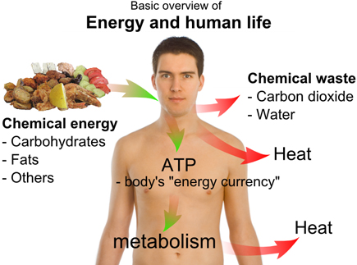
Cellular Respiration
The process of breaking down food molecules to release energy
Plants, algae, animals and some bacteria use cellular respiration
Two basic types: aerobic and anaerobic

Slide 16
Formula for Cellular Respiration
Sugar
Oxygen

Slide 18
3 Parts of Cellular Respiration
Glycolysis
Krebs Cycle (Citric Acid Cycle)
Electron Transport Chain

Slide 19
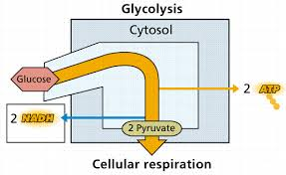
1. Glycolysis
occurs in the cytoplasm
anaerobic (does not use oxygen)
Glucose is broken down

Slide 20
2. Kreb’s Cycle
Occurs in the mitochondria
Aerobic: requires oxygen
Some ATP produced

Slide 21
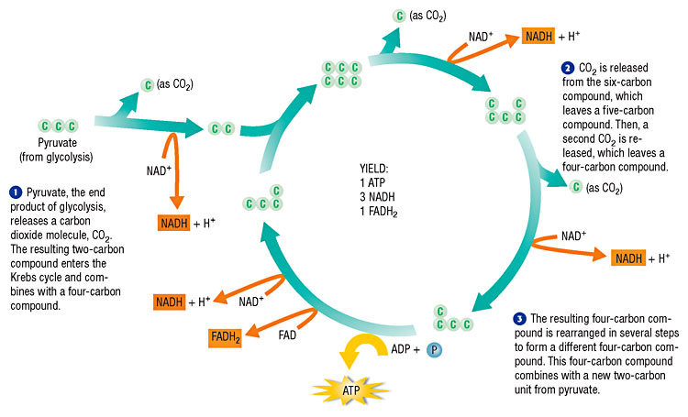

Slide 22
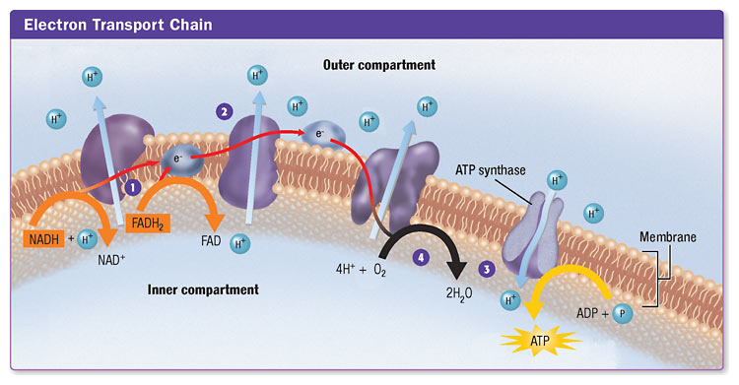
3. Electron Transport Chain (ETC)
occurs in the inner membrane of the mitochondria
requires oxygen (aerobic)
makes a large amount of ATP

Slide 23
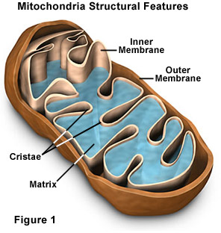

Slide 24
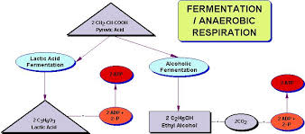
Fermentation
If there is no oxygen available (anaerobic) then organisms make energy through fermentation.

Slide 25
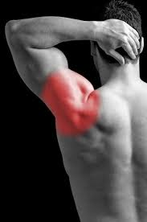
1. Lactic Acid Fermentation (animals)

Slide 26
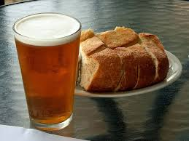
2. Alcoholic Fermentation (yeast & plants)

Slide 27
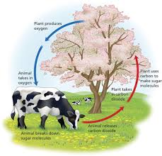
Photosynthesis and cellular respiration are opposite processes.

Slide 28
Quick Quiz
What is the formula for photosynthesis?
What are the 2 stages of photosynthesis?
Where does photosynthesis happen in the cell?
What factors might effect photosynthesis?
Why are photosynthesis and cellular respiration considered opposite processes?

