Slide 1
Protein Synthesis

Slide 2
How does a gene control a trait? Usually, by directing the synthesis of a protein.
This involves 2 processes:
Transcription = using one side of the DNA of a gene as a template for making a complementary strand of mRNA
Translation = a ribosome “reads” the coded information in the mRNA and uses that to assemble a sequence of amino acids (a protein) with the help of tRNA

Slide 3
To make a protein, what information is needed?
Need to know which amino acids to use and the order in which they need to be assembled
How can a gene have this information?
The information is written in 3-letter CODE WORDS. Each code word is a sequence of 3 nitrogen bases in a gene.
ex: TAC or TTT, etc.

Slide 4
Where are the genes located?
in the nucleus
(each chromosome is a sequence of genes)
Where are the proteins made?
in the cytoplasm (ribosomes)
Do you think that a gene can leave the nucleus?
NO

Slide 5
Questions to consider:
1. How can the CODE for making a particular protein get from the gene in the nucleus out to a ribosome?
2. Of what are ribosomes made?
3. How will the necessary amino acids to delivered to the ribosome?

Slide 6
The answers to these questions are found as we look at the 3 types of RNA.

Slide 7
Review: RNA Nucleotide Structure
REMEMBER:
RNA does not contain thymine. In its place, RNA has Uracil. The sugar is ribose instead of deoxyribose.

Slide 8
RNA
RNA molecules are single strands of nucleotides.
The 3 types of RNA are:
mRNA = messenger RNA
rRNA = ribosomal RNA
tRNA = transfer RNA
SO … BACK TO OUR QUESTIONS . . . . . . . . .

Slide 9
1. How can the CODE for making a particular protein get from the gene in the nucleus out to a ribosome?
The code is transferred from the nucleus to a ribosome in the form of a mRNA (messenger RNA) molecule.
This mRNA molecule is made in the nucleus by an enzyme called RNA Polymerase in the process called TRANSCRIPTION.

Slide 10
The sequence of nitrogen bases in mRNA is determined by the sequence of nitrogen bases in the DNA of the gene being expressed.
Each 3 letter code word in mRNA is called a codon (ex: AUG, AAA, etc.).
The mRNA leaves the nucleus and finds a ribosome.

Slide 11
Transcription (T_{c})

Slide 12
2. Of what are ribosomes made?
Ribosomes are made of rRNA (ribosomal RNA) and protein. Each is composed of a small subunit and a large subunit. The small subunit binds mRNA first to initiate TRANSLATION. Then the large subunit is added to form a complete ribosome. The large subunit has a “P” site and an “A” site.

Slide 13
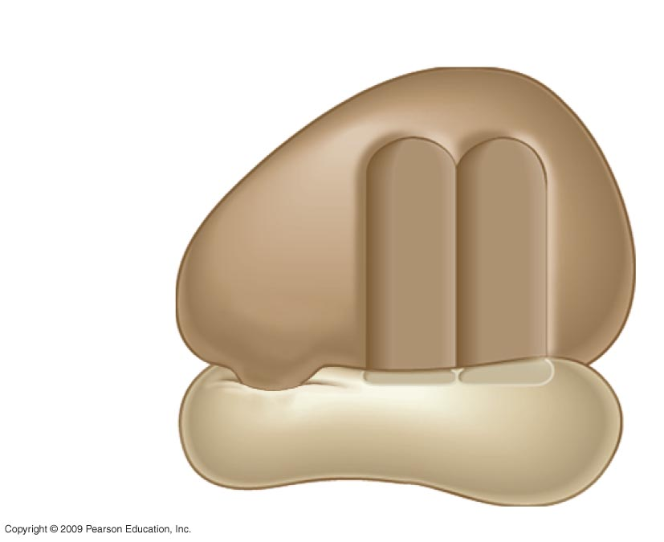
Structure of a Ribosome (composed of rRNA + protein)
0
tRNA-binding sites
Large
subunit
mRNA
binding
site
Small
subunit

Slide 14
3. How will the necessary amino acids to delivered to the ribosome?
The necessary amino acids are delivered to the ribosome by tRNA (transfer RNA) molecules.

Slide 15
Transfer RNA (tRNA)

Slide 16
How will a specific tRNA molecule “know” that the amino acid it carries is needed?
Each tRNA has a 3-nitrogen base sequence called an ANTICODON. During TRANSLATION when a ribosome is reading a particular CODON, the tRNA with the complementary ANTICODON locks on and delivers its amino acid.

Slide 17
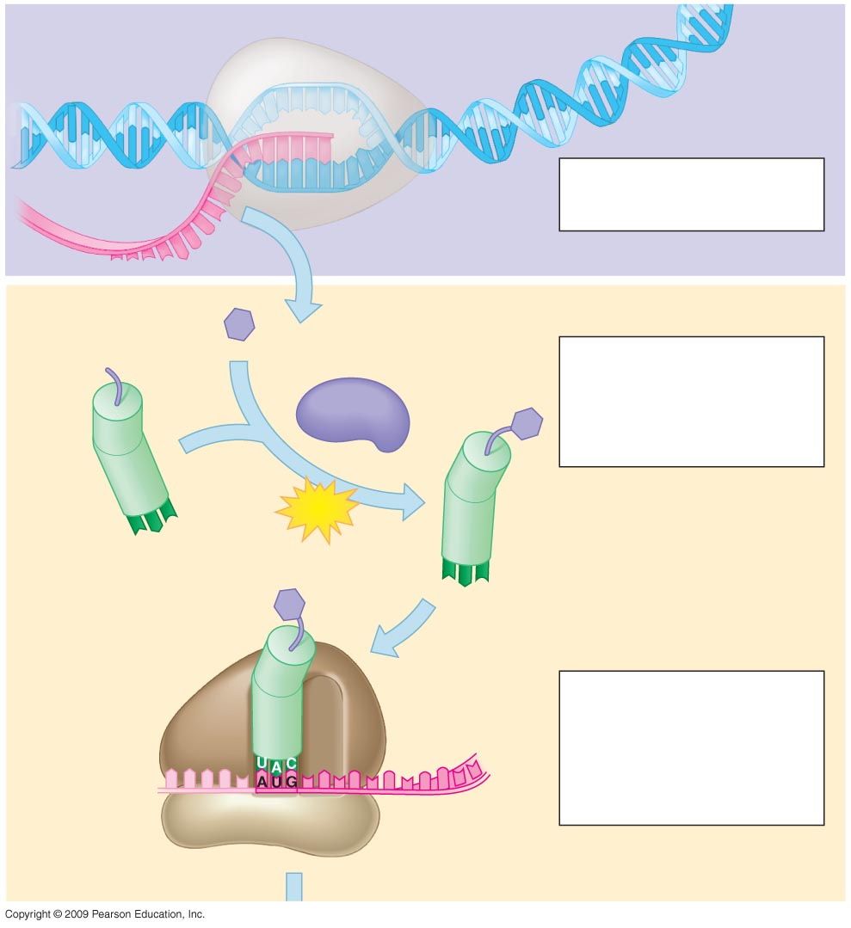
DNA
Transcription
0
mRNA is transcribed
from a DNA template.
1
mRNA
RNA
polymerase
Amino acid
Translation
2
Each amino acid
attaches to its proper
tRNA with the help of a
specific enzyme and
ATP.
Enzyme
ATP
tRNA
Anticodon
Initiator
tRNA
Large
ribosomal
subunit
3
Initiation of
polypeptide synthesis
The mRNA, the first
tRNA, and the ribosomal
sub-units come together.
Start Codon
Small
ribosomal
subunit
mRNA

Slide 18
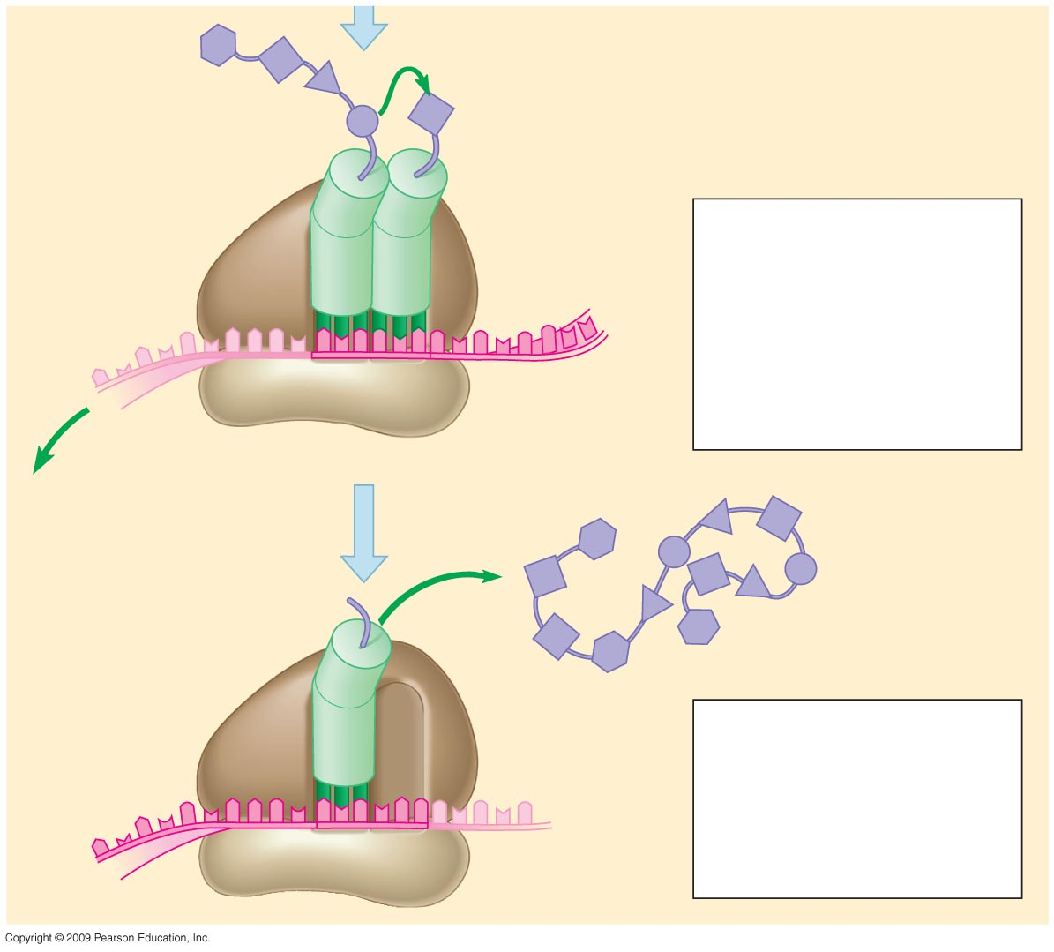
0
New peptide
bond forming
Growing
polypeptide
4
Elongation
A succession of tRNAs
add their amino acids
to the polypeptide chain
as the mRNA is moved
through the ribosome,
one codon at a time.
Codons
mRNA
Polypeptide
5
Termination
The ribosome
recognizes a stop
codon. The polypeptide
is terminated and
released.
Stop codon

Slide 19
What type of bond forms between the amino acids as they are brought in to form a protein?
PEPTIDE
BONDS

Slide 20
Protein Synthesis
http://highered.mcgraw-hill.com/sites/0072437316/student_view0/chapter15/animations.html#

Slide 21
Review
Transcription (T_{c})
Occurs in nucleus
RNA Polymerase uses 1 side of a gene as a template to make a complementary mRNA.
Translation (T_{l})
Occurs in cytoplasm
Ribosomes read codons; tRNAs bring in the correct amino acids

Slide 22
PRACTICE:
Consider the following segment of a DNA molecule (only the nitrogen base pairs are shown; the sugar-phosphate backbone of each strand is understood to be present):
--A T G T T A C A C G A A A G A T G A--
--
Pretend that this segment of DNA = a gene for a protein. Note: Only one side of the gene is used as a template to transcribe a mRNA molecule. Let’s use the bottom half of our practice gene.

Slide 23
Transcribe this DNA base sequence into a mRNA base sequence.
DNA | TAC | AAT | GTG | CTT | TCT | ACT
mRNA codon
tRNA anticodon
amino acid
Fill in tRNA anticodons. Use the CODONS & the genetic code chart on p. 222 to fill in the appropriate amino acids.

Slide 24
The Genetic Code
The genetic code was broken in the early 1960’s. Note that:
1. in the genetic code, more than 1 codon can specify the same amino acid; the 3rd position of each codon is called the “wobble” position; code is REDUNDANT
2. in the genetic code, no codon specifies more than one amino acid; code is not AMBIGUOUS
3. the genetic code contains some codons that are signals:
-AUG is a start codon that specifies Met -UAA UAG UGA are all stop codons that signal for the ribosome to stop translation
4. the genetic code is universal – is shared by all organisms from the simplest bacteria to the most complex plants and animals.

Slide 25
How can we work with the Genetic Code?

Slide 26
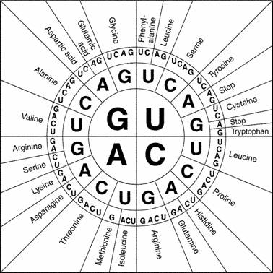
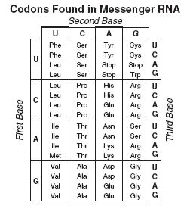
Different formats for Genetic Code Chart:

Slide 27
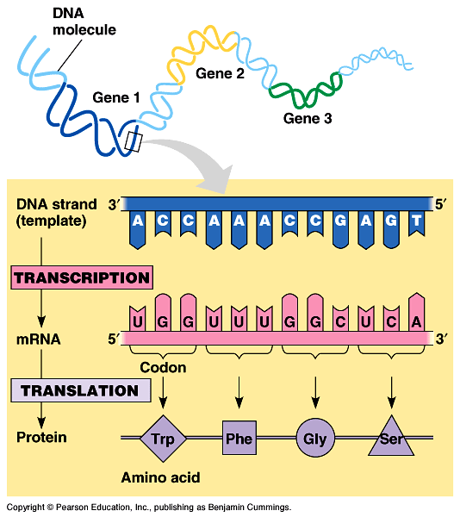
Review of how a gene directs the synthesis of a protein:

Slide 28
Enough notes for today.

