Slide 1
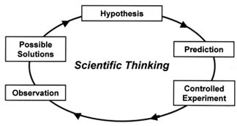
Scientific Method
The scientific method is the process scientists use to determine the truth. There are four steps.

Slide 2
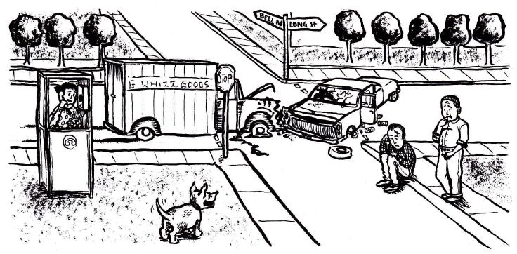
1. Observation
Making an observation or seeing a problem. Based on this you may make an inference about your observation

Slide 3
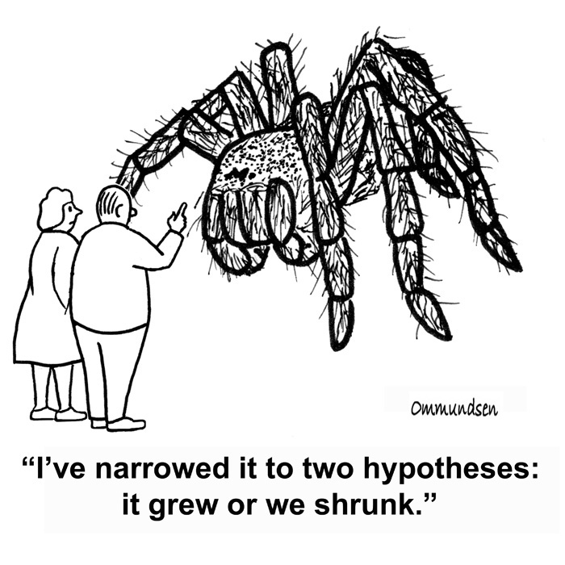
2. Hypothesis
A testable, possible solution. Your inference may lead to your hypothesis.

Slide 4
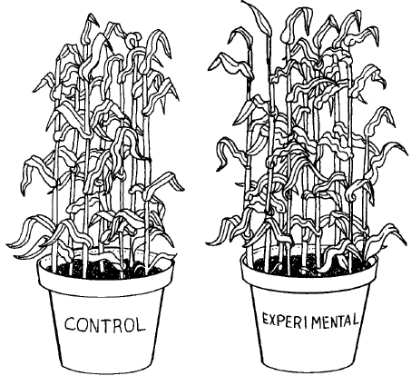
3. Experiment-
A controlled method of testing a question. Only ONE variable is changed at a time. All other Variables should be kept unchanged.

Slide 5
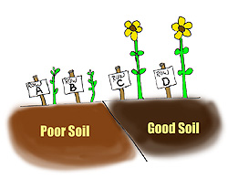
4. Conclusion:
Was your hypothesis correct? Does it lead to further inquiry?

Slide 6
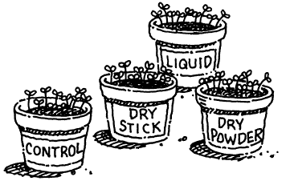
Independent Variable
Manipulated variable that is deliberately changed

Slide 7
Dependant Variable
Responding variable that is observed IN RESPONSE to the Independent variable

Slide 8
Control
The experimental component in which no variables are applied. Used as a source of comparison.

Slide 9
Constants
Experimental components which must remain the same. They show if the experimental variable affected the outcome

Slide 10
Video clip time
lets see if this cartoon helps...

Slide 11
1
GRAPHS

Slide 12
What is a graph?
2
A graph is a visual display of information or data.
Why use a graph?
It allows us to interpret information faster and easier than a data table.

Slide 13
Line Graphs
3
Line graphs are effective at showing a relationship where the dependent variable (DV) changes due to a change in the independent variable (IV).
The DV is placed on the y-Axis (vertical axis). The IV is placed on the x-Axis (horizontal axis).

Slide 14
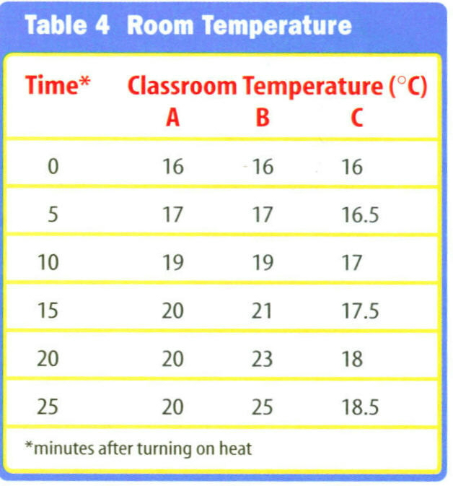
4

Slide 15
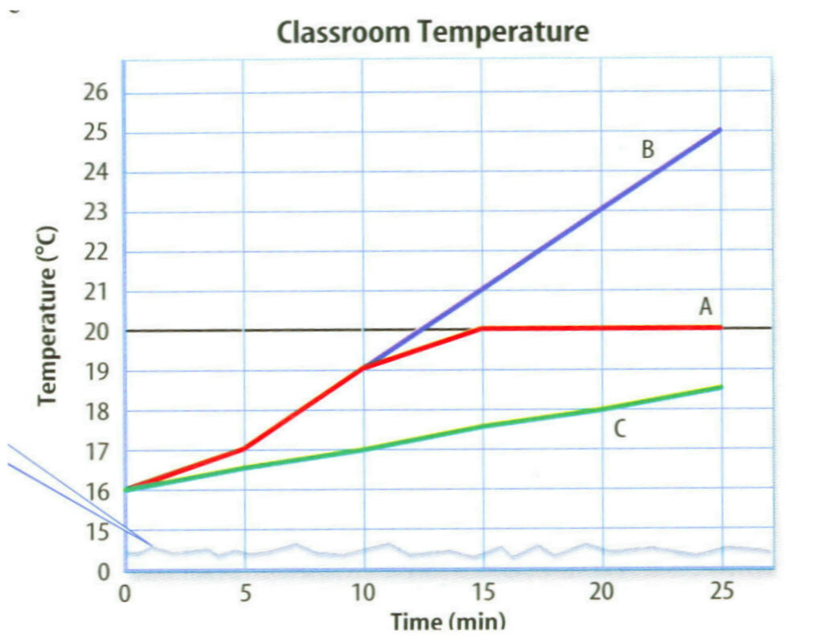
5

Slide 16
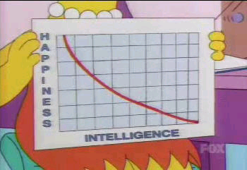
6

Slide 17
Bar Graphs
7
Bar graphs are useful for comparing information collected by counting.

Slide 18
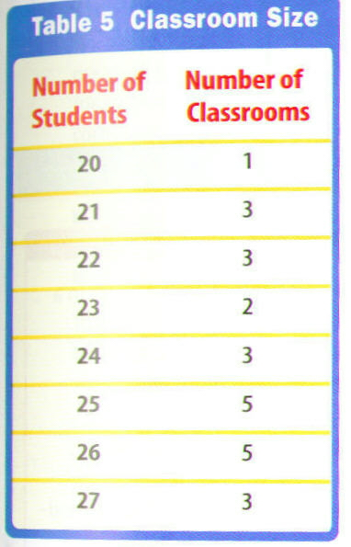
8
Again, tables aren’t always the most efficient way to interpret data.

Slide 19
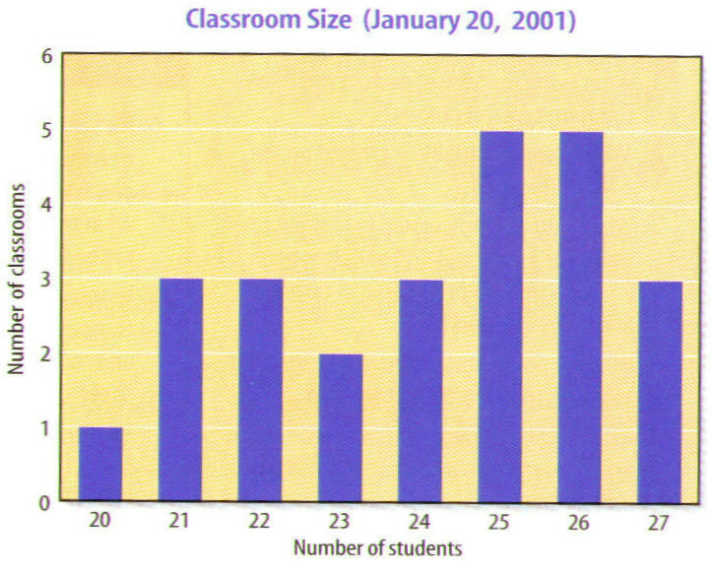
9
What classroom size is the most common?

Slide 20
10

Slide 21
Circle Graphs
11
Circle graphs are sometimes called pie graphs.
Circle graphs show how a fixed quantity is broken down into percentages.

Slide 22
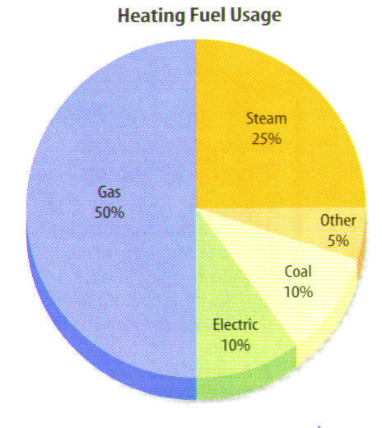
12

Slide 23
Important Stuff
13
Remember: The independent variable (IV) goes on the X-axis (horizontal axis).
The dependent variable (DV) goes on the Y-axis (vertical axis).
Label both axes!!!
Include your units!!!
Keep your scale consistent for each axis.

Slide 24
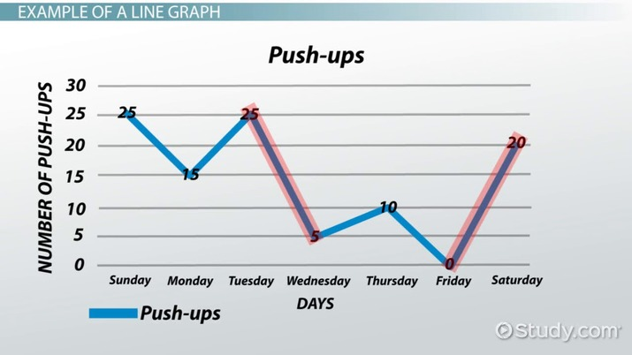
14
Proper Labeling of a Graph
Title
Y-Axis Labeled
Data
Proper Scale
Key
X-Axis Labeled

Slide 25
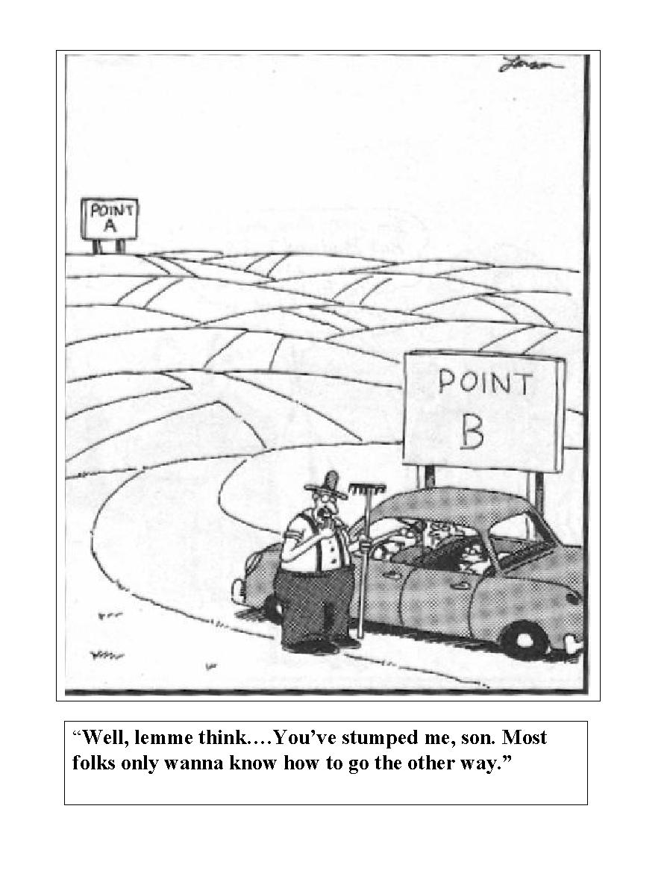
15

