Slide 1
Notes: The 6 Kingdoms
SB3b. Compare how structures and function vary between the six kingdoms (archaebacteria, eubacteria, protists, fungi, plants, and animals)

Slide 2
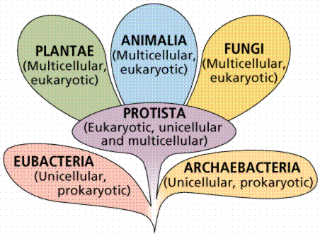
The Kingdoms
Archaeabacteria Eubacteria Protista
Fungi
Plantae Animalia

Slide 3
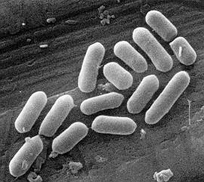
Kingdom Archaeabacteria
“Ancient Bacteria”
Prokaryotes (no nucleus) Unicellular
Cell walls do not have peptidoglycan First organisms to inhabit earth
Live in extremely harsh environments- like hot springs, volcanoes, the Dead Sea, & near ocean vents.
Their RNA is different from the next
kingdom of bacteria

Slide 4
Kingdom Eubacteria
“True Bacteria”
Prokaryotes (no nucleus) unicellular
Have cells walls of peptidoglycan
These are the common bacteria that are found everywhere. Can be free-living or parasitic
Can be aerobic or anaerobic
Can be autotrophs or heterotrophs

Slide 5
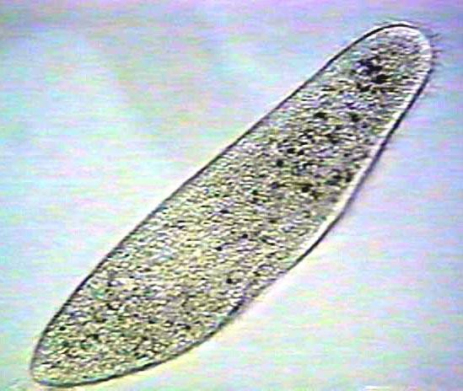
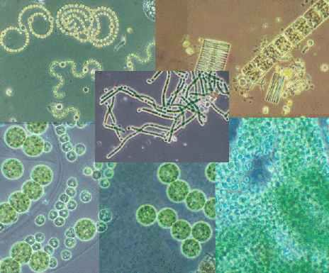
Kingdom Protista
– the “catch-all” kingdom
Eukaryotes (complex cells with a nucleus)
Autotrophs & heterotrophs
Unicellular and multicellular Mobile and nonmobile
EX: paramecium, amoebas,
& algae
All other eukaryotic kingdoms probably evolved from protists

Slide 6
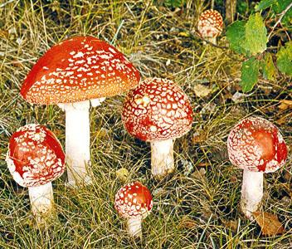
Kingdom Fungi
Eukaryotes
Multicellular
Cell walls made of chitin
Do not move (non-mobile)
Heterotrophic- They absorb food from their surroundings (usually from dead & decaying organic matter- they are known as decomposers)
EX: mushrooms, mold, yeast, mildew

Slide 7
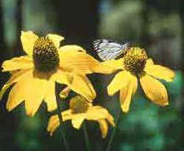
Kingdom Plantae
Eukaryotes Multicellular
Cells walls made of cellulose
Do not move (non-mobile)
Autotrophic-produce their own food using
chloroplasts (photosynthesis)
Cells are organized into tissues, organs, & organ
systems
EX: trees, grasses, herbs, flowering plants, & ferns

Slide 8
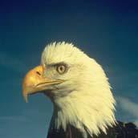
Kingdom Animalia
Eukaryotes Multicellular No cell walls
Mobile (at least during some part of their life span)
Heterotrophic (consumers)
Cells are organized into tissues, organs, & organ systems.
Have more species than any other Eukaryotic kingdom. Includes sponges, jellyfish, insects, birds, mammals, etc.

